Slide 1


FIELDS early project results
Remigio Berruto, Coordinator
Patrizia Busato, former Coordinator
Francesca Sanna, Project Manager
4th Virtual Project Monitoring Meeting
17 March 2021

Slide 2




























PARTNERS

Slide 3

Pact for skills: communication with EU Commission
Remigio Berruto – UNITO,
FIELDS Coordinator
Daniele Rossi – CONFAGRICOLTURA,
Chairman Copa-Cogeca Research & Innovation

Slide 4
Pact for Skills – shared engagement and approach to skills development
Commission is launching a Pact for Skills — a shared engagement and approach to skills development.
The Pact is firmly anchored in the principles of the European Pillar of Social Rights and supports the goals of the Green Deal and the digital transformation
The Pact aims to mobilise and incentivise private and public stakeholders to take concrete action for the upskilling and reskilling of people of working age, and, when relevant, pool efforts in the partnerships.

Slide 5
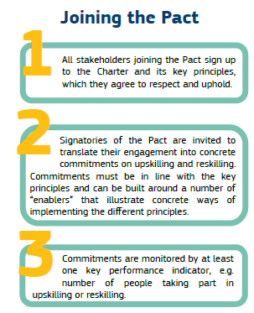
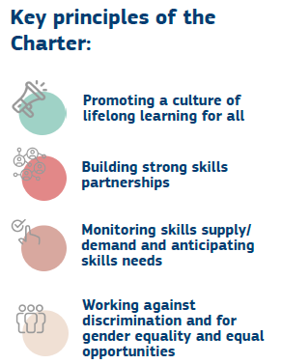
Pact for Skills – shared engagement and approach to skills development

Slide 6
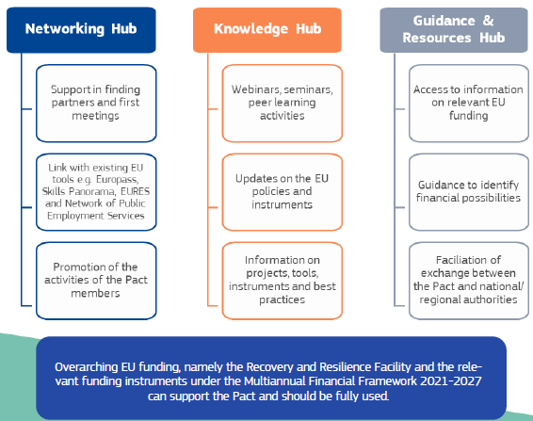
EU Commission support for the implementation og the pact for skills

Slide 7
Pact for Skills Roundtable with Commissioners Schmit and Breton for the Agri-food Ecosystem
On Feb, 18, 2021
brought together executive representatives of industry, sectoral organisations, social partners, educational and training organisations
Urgent to address the skills needs of the agri-food ecosystem in order to successfully achieve and benefit from the green and digital transition.
Upskilling and reskilling workers along the food supply chain will strengthen the resilience of this vital ecosystem
Needs of farmers and food SMEs have to be addressed immediately. Urgent to motivate people, in particular the young, to be part of this ecosystem, especially in rural areas
Vocational and peer-to-peer training as well as best practices exchange and dissemination through the creation of a professional network at European level
Address the current skills gap, strengthen its resilience and reach the Green Deal targets.

Slide 8
Pact for Skills Roundtable with Commissioners Schmit and Breton for the Agri-food Ecosystem
Participants with clear commitments of involvement, could already embrace the proposed Pact for skills initiative
Both Commissioners underscored the importance of collaboration, especially given the integrated nature of the food supply chain
Clear ideas and commitments would have to be agreed upon soon, in order to establish agri-food skills partnerships in the immediate future.
The Sector Skill Alliance we are going to sign goes already in this direction
The main documents of Pact for Skill will be uploaded to the management portal after the meeting, and we will organise meeting to think about FIELDS contribution in this regard

Slide 9
Activities and deliverable progress

Slide 10
Agenda - Project results & Future activities
 | AGENDA | Contributors
9:30 | Welcome Remigio Berruto, Fields Coordinator Urška Primec, Project officer – EACEA | Remigio Berruto/ Patrizia Busato (UNITO)
9:40 | Pact for skills: communication with European Commission | Remigio Berruto / Daniele Rossi
9:50 | WP1 - Skills needs identification (ISEKI) Task 1.1: State of the Art (UNITO), M1-M6 Task 1.2: Stakeholders strategic mapping (LLL-P), M1- M6 Task 1.3: Country and EU focus groups (ISEKI), M2-M9 Task 1.4: Bottom-up surveys (ICOS), M9-M12 Task 1.5: Future trends analysis (WUR), M8-M15 | Luis Mayor Francesca Sanna (UNITO) Maria Joao Proença (EfVET)/ Pauline Boivin (LLL.P) Luis Mayor (ISEKI) Billy Goodburn (ICOS) Jacques Trienekens (WUR)
10:40 | WP1 – Q/A
10:50 | Virtual Coffee break
11:00 | WP2 – Priorities and strategy design (CONFAGRI) Task 2.1: Analysis of skill gaps and new profiles creation (AC3A), M12-M15 Task 2.2: Profiles prioritization (Confagri PT), M14-M18 Task 2.3: European strategy formulation (WUR), M12-M48 | Daniel Rossi/Camilla Tomao Alexandre Morin/ Alexandre Desbourdes (AC3A) Domingo Godinho (ConfagriPT) Jacques Trienekens (WUR)
11:30 | WP2 – Q/A

Slide 11
Agenda - Project results & Future activities
 | AGENDA | Contributors
11:50 | WP3 - New tools and training design (UNITO) Task 3.1: Methodology definition (UNITO), M4-M9 | Remigio Berruto (UNITO)
12:00 | WP3 – Q/A
12:10 | WP4 - Implementation (AERES) Task 4.3: Map creation, update and use (UNITO), M4-M48 Task 4.4: Translation (CONFAGRI), M4-M48 | Marg Leijdens Francesca Sanna (UNITO) Camilla Tomao (CONFAGRI)
12:30 | WP4 – Q/A
12:40 | Lunch time
13:40 | WP5 - Sustainable action plan (ICOS) Task 5.1: National and EU regulatory frameworks (ConfagriPT), M7-M20 Task 5.2: Funding opportunities (LLL-P), M7-M20 | Billy Goodburn Cátia Rosas (ConfagriPT) Pauline Boivin (LLL-P)
14:00 | WP5 – Q/A
14:10 | WP6 – Quality Assessment (CERTH) Task 6.1 - D6.1: Quality plan (CERTH), M1-M4 Task 6.1 - D6.2: Evaluation Grids (INFOR), M5-M6 Task 6.2: Quality assessment (EFB) M5-M48 | Dionysis Bochtis Irene Aivazidou/ Efthimios Rodias (CERTH) Giuseppe Vanella (INFOR) C. Koidis/D. Aidonis (EFB)
14:30 | WP6 – Q/A

Slide 12
Agenda - Project results & Future activities
 | AGENDA | Contributors
14:40 | Virtual Coffee break
14:50 | WP7 - Dissemination and communication (ACTIA) Task 7.1: Dissemination plan (LVA), M1-M9 Task 7.2: Communication and dissemination campaign (FIAB), M1-M48 | C. Cotillon/G. Cornuau Julian Drausinger/ Katerina Stollewerk (LVA) Concha Avila (FIAB)
15:15 | WP7 – Q/A
15:30 | WP8 - Project Management (UNITO) Task 8.1: Decision making and internal communication, M1-M48 Task 8.2: Administrative and financial management, M1-M48 Task 8.3: Progress monitoring and risk management, M1-M48 | Remigio Berruto / Francesca Sanna (UNITO)
16:00 | Future activities and next meetings
16:40 | Questions and Comments
17:00 | Conclusion and greetings
 | The meeting will be recorded and presentations made available in the FIELDS management portal

Slide 13
Thank you for your attention!
Francesca Sanna, FIELDS project manager
francesca.sanna@unito.it

