Slide 1

FIEDS 2nd partnering meeting – 29.06.2020
WP7 – Dissemination and communication
ACTIA - Christophe Cotillon - c.cotillon@actia-asso.eu ACTIA – Gemma Cornuau – g.cornuau@actia-asso.eu LVA – Julian Drausinger – julian.drausinger@lva.at FIAB – Conchà Avila – c.avila@fiab.es

Slide 2
WP7 Info
WP Start/end date: M1-M48
Lead by ACTIA and all partners are involved
WP7 aims to ensure to reach the largest possible target audience while advertising the project results
The network of the associated partners (EFFAT, BIC) and of the entity supporting the project (COPA-COGECA) will also be used for a wider reach of farmer association and cooperatives
A dissemination plan will be developed by LVA to support the outreach of the project to the target audiences in the participating countries and following succesful validation to other countries.

Slide 3
T7.1 Dissemination plan
Duration: M1-M9 Leader: LVA (60 days)
Involved: CONFAGRI (20 days), UNITO (30 days), FIAB (18 days), ACTIA (18 days)

Slide 4
T7.1 Dissemination plan
The task 7.1. aims to define the overall communication and dissemination plan
Deliverable 7.1: Dissemination plan, M9
  to be developed by LVA in collaboration with FIAB, CONFAGRI, ACTIA and UNITO
  to be validated by all project partners during a project meeting
  common goal: communicating and disseminating the project’s objectives outputs, interim and final results
The main content of dissemination plan is to develop a strategy to:
o outline key dates/ times of dissemination activities
around the dates of deliverables of the WPs.
based
o identify most efficient methods to ensure project results and strategies are communicated and adopted by EU policy makers and into existing and future legislation at EU and Member states

Slide 5
T7.2 Communication and dissemination campaign
Duration: M1-M48 Leader: FIAB (155 days) Involved: All partners

Slide 6




COMMUNICATION MATERIAL
CON LA SALUD
LOGO
UNITO – Month 1 – 4 LOGO proposals presented by ACTIA. One logo has been chosen by partners
TEMPLATES
UNITO Month 1 – 4 – PowerPoint, Word, Publisher – Waiting for logo
UNITO – FENACORE – Month 1 – 4 – Translation in German (LVA),Spanish (FIAB-FENACORE), Finnish (PA), French (ACTIA), Italian (CONFAGRI), Dutch (AERES),Greek (CERTH), Portuguese (CONFAGRI PT), Slovenian (GZS-ZKZP) Ongoing
LEAFLET

Slide 7
COMMUNICATION MATERIAL
UNITO – Month 1 – 6 – In English and translated in 9 partners’ languages – Hosting plan for 8 years (to ensure sustainability of the platform 4 years after Project’s end. Web analytics tools will be used to monitor web performance –
website ONGOING http://www.erasmus-fields.eu/
website DATABASE RUNNING http://www.erasmus-fields.eu/management/
WEBSITE
NEWSLETTERS
FIAB – Month 6 - Each 6 months with inputs of WP leaders – In English and translated in all partners’ languages.
Proposal for the 1st Newsletter:
Overall description project and partners
Focus Groups in each country

Slide 8
COMMUNICATION MATERIAL
Abstract of the project in each partners website with a link to FIELDS
http://fiab.es/project/fields/
https://www.actia-asso.eu/projets/fields/
Press Releases/Articles published by partners
http://fiab.es/fiab-participa-en-el-proyecto-fields-para-formar-en-sostenibilidad-bioeconomia-y-digitalizacion-a-los-trabajadores-del-sector-agroindustrial/
http://www.agro-alimentarias.coop/1/1_2_1.php?id=OTA1MQ==
Articles to be published in relevant journals to reach targeted audience detailed and according to Dissemination plan task 7.1
https://www.olimerca.com/noticiadet/los-agricultores-europeos-se-van-de-erasmus/d5bbdaa12b31fcea2bc6a37f6ed911c9
Thanks to Cooperativas Agro Alimentarias!
DISSEMINATION TO MEDIA
ARTICLES AND PRESS RELEASES

Slide 9
COMMUNICATION MATERIAL
DISSEMINATION TO MEDIA
ARTICLES AND PRESS RELEASES
Dissemination towards EIP-AGRI focus group will be performed by UHOH
FDE will disseminate project results through National Food and Drink Federations and National Food Technology Platforms at the different stages development of the project
http://foodforlife-spain.es/?s=fields&post_type=post

Slide 10


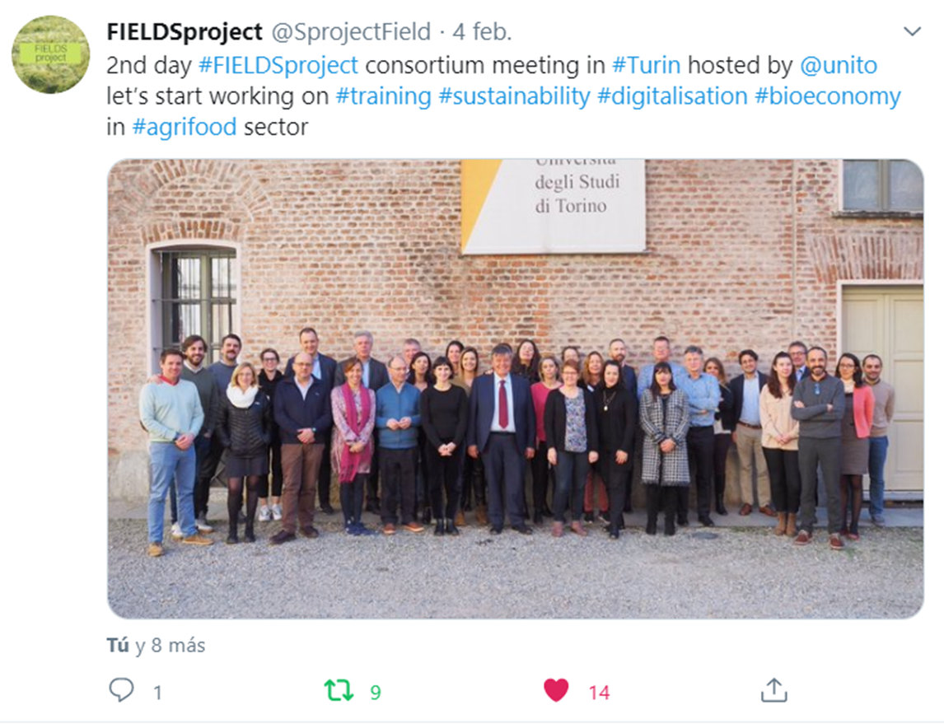

SOCIAL MEDIA

Slide 11
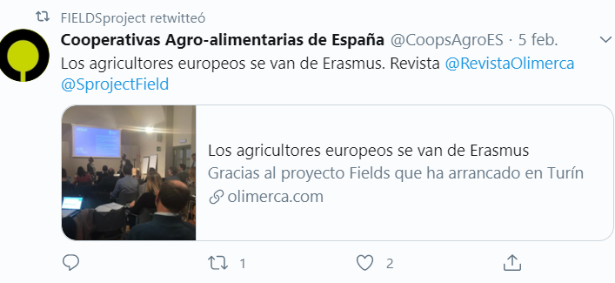

SOCIAL MEDIA

Slide 12
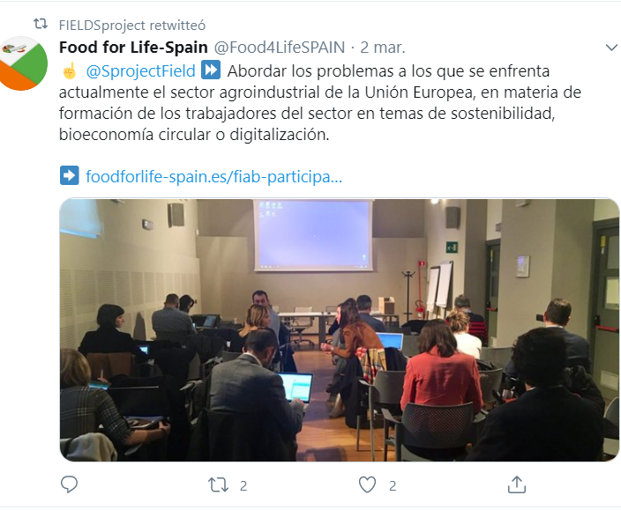
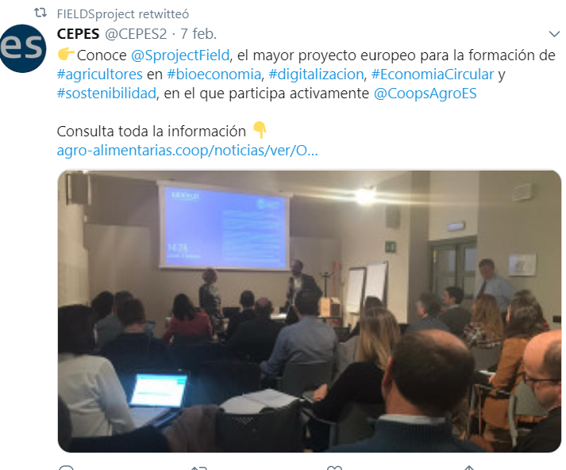
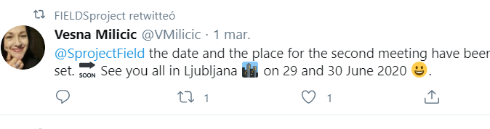
SOCIAL MEDIA

Slide 13
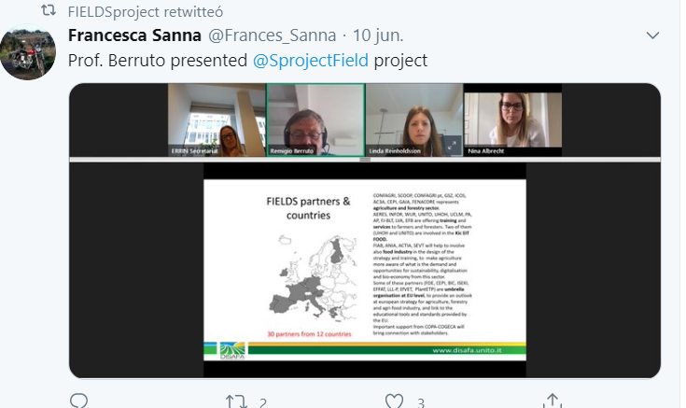
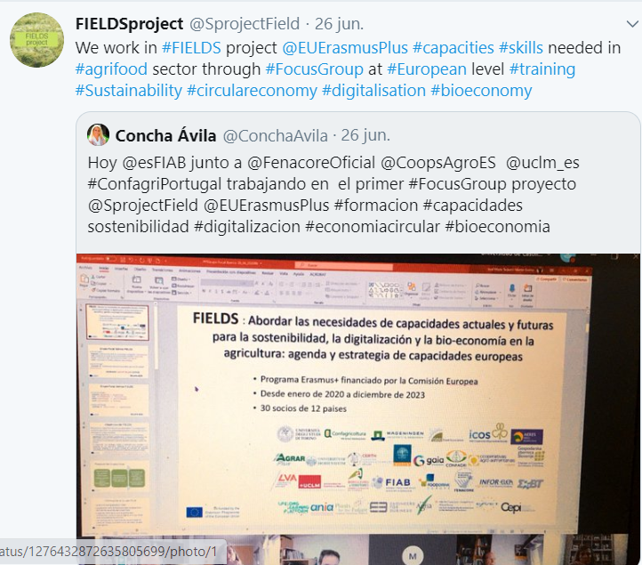
SOCIAL MEDIA

Slide 14
OTHER COMMUNICATION ACTIVITIES
WORKSHOPS
7 national Workshops (LVA, AERES,CONFAGRI,ACTIA,FIAB, ICOS, PA) – (engagement of Farmers, foresters, industry organisations, VET and education providers)
1 Final Conference in Brussels - All partners and the umbrella organisations (FDE, Copa Cogeca, WP RES, EFFAT, CEPI)
FIELDS PRESENTATIONS
All partners will identify events, workshops, meetings or conferences related, to present FIELDS goals, ongoing works, results to attract stakeholders and reach targeted audience.

Slide 15
DELIVERABLES
D7.2 Public Website (Month 4)
D7.3 Project leaflet and poster (M6)
D7.4 Report on dissemination action (M48) – FIAB will prepare one dissemination report per year with the inputs of all partners and presents updates each e-meeting

Slide 16
Thank you for your attention !
Q&A

