Slide 1
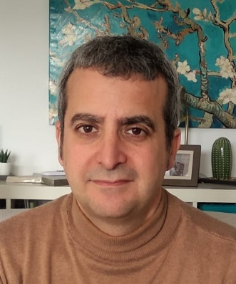
WP1– Tasks 1.1 and 1.2 overview
FIELDS – Databases presentation– 7/5/20
Luis.Mayor@iseki-food.net

Slide 2
Tasks 1.1 and 1.2 overview
FIELDS WP1
WP Start/end date: M1-M15
Partners involved: All
Aim: Establish a general overview of the labor market in agriculture, forestry and related sectors (food industry, forest-based industry) in order to define present and future skills needs related to Sustainability, Digitalisation, Bioeconomy and Soft Skills.
The outputs of this work package will be directly used in WP2, WP3, WP4 and WP7.

Slide 3
Tasks 1.1 and 1.2 overview
FIELDS WP1 - Tasks
Task 1.1: State of the Art (UNITO)
Task 1.2: Stakeholders strategic mapping and mobilisation (LLL-P)
Task 1.3: Country and EU focus groups (ISEKI)
Task 1.4: Bottom-up surveys (ICOS)
Task 1.5: Future trends analysis (WUR)
Ongoing Tasks: 1.1, 1.2 and 1.3
Task 1.4 starts M9 (September)
Task 1.5 starts M8 (August)

Slide 4
Tasks 1.1 and 1.2 overview
Task 1.1. State of the Art (UNITO)
All partners will provide information related to their domain: curricula available, best practices, relevant projects, (EU, regional), examples of policies and initiatives at national-european levels.
UNITO will create a database. Partners will provide information according their specialization angle:
Agricultural sustainability, management of natural resources and climate action: UNITO, CONFAGRI, ICOS, ISEKI, FIAB, SCOOP, UHOH, CEPI, FDE, ACTIA, ANIA, EFFAT, CERTH, EFB, PlantETP, AP, LVA, SEVT, FIAB, UCLM, PA, GZS-ZKZP, AC3A, BIC, EfVET, FENACORE
Digital technologies, digitalization, big data and artificial intelligence: UHOH, CERTH, EFB, PA, UCLM, SCOOP, UNITO
Bio-economy, circular economy and bio-based products: ISEKI, FIAB, LVA, UHOH, CEPI, AP, CERTH, EFB, ACTIA, SEVT, UCLM, ICOS, SCOOP, AC3A, CONFAGRI, BIC, EfVET, PlantETP
EfVET and LLL-P will lead a search of available frameworks, action plans, materials, studies (ESCO, EQAVET, PanoramaSkills, etc) and how to link them with the project.
Partners will cooperate at national level to make advantage of synergies in their research.
Additional indications for data collection are found in the DoW, please check

Slide 5
Tasks 1.1 and 1.2 overview
Task 1.1. State of the Art (UNITO)
Deliverables
D1.1: Stakeholders strategic plans and analysis report (M6)
Report on the growth strategy of the sector, summarized through the available material and directives from the EU, producers associations and industries (UNITO, UHOH, CONFAGRI and WUR).
D1.2: Repository of previous projects, results and best practices (M6)
Database
We are trying to meet the deadlines. Due to Covid-19 situation we are expecting potential delays.

Slide 6
Tasks 1.1 and 1.2 overview
Task 1.2. Stakeholders strategic mapping and mobilisation (LLL-P)
Database on education and VET providers. Sectors: agriculture, forestry and bio-economy (food and forest-based industries). Information to collect will be indicated later in this event. Target: 30 institutes for year one and 120 until the end of the project.
Database of stakeholders, that might have an interest in the project. Information to collect will be indicated later in this event. Those stakeholders will be involved in WP7 and will be contacted to provide specific information when needed.
CONFAGRI will coordinate the classification of the target groups and their accessibility (to be used for WP2 and WP3) to:
identify potential gaps in the scope and reach of the target groups and plan contingency measures
analyse the evolution of empirical practices towards a structured pedagogical approach aimed at large target groups
D1.3: VET list and classification (M6)

Slide 7
Many thanks for your attention! Questions/comments at the end of this event

