Slide 1
Addressing the current and Future skIll needs for sustainability, digitalization and the bio-Economy in agricuLture: European skills agenDa and Strategy
FIELDS 2nd partnering meeting 29/06/2020
Task 1.2: Stakeholders strategic mapping, LLLP, M1- M6
Riccardo Gulletta
Maria João Proença

Slide 2
LLLP and EfVET set an agriculture, forestry and bio-economy education and VET providers’ list…
The database
All partner organisations involved in the consortium are contributing to the mapping exercise, introducing information in the online database embedded in the FIELDS online platform
The database will register and index the providers with their activities, certification, curricula, interest for collaboration, search for partners, language and place
A target of 30 institutes to populate the platform is set for year one and a target of minimum 120 is set until the end of the project

Slide 3
The mapping helps to identify potential stakeholders interested in the project, to be involved in WP7 Dissemination and communication activities.
The mapping ensures a further classification of stakeholders in specific target groups, with a special focus on their accessibility through each partner organisation; this classification supports the planned tasks and activities included in WP2 Priorities and strategy design and WP3 New tools and training design.

Slide 4
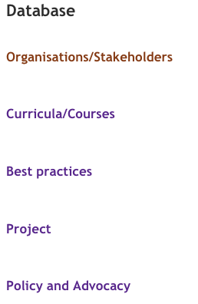
The database
The database is structured as following:
Organisations/Stakeholders
Curricula/Courses
Best practices
Project
Policy and Advocacy

Slide 5
Organisations/Stakeholders
Besides VET schools and VET providers, the database includes as stakeholders the following categories: agriculture; chamber of agriculture; college; cooperatives; farmers; farmers’ representatives; farmers’ advisors; food industry; foresters’ representatives and advisors; forestry; industries; industry representatives; institutional stakeholder; international stakeholder; ministry; mobility agency; pulp/paper industry; research institute/centre; trainers; unions; universities; and other.
A search per “Country” and/or “Stakeholder type” is foreseen.

Slide 6
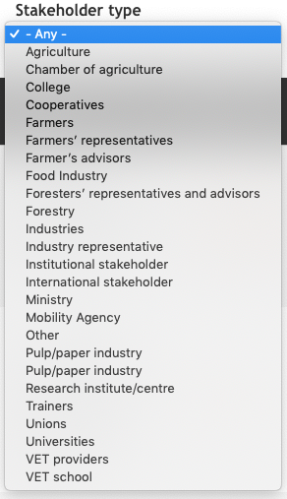
For each organisation/stakeholder the following information is provided:
Title and name
Type of organisation/stakeholder (see the previous categories)
A short description
Address and country
Website, contact person, email
Any further comment

Slide 7
Curricula/Courses
The Curricula/courses database complements the information on VET schools, VET providers and other educational providers in general. A search per “country”, “stakeholder type” and “keywords” is foreseen. For each curriculum and course the following information is provided:
The title of the course/curriculum
The organisation who manages, leads, organises or prepares the curriculum/course
A short description
The country of the organisation delivering the curriculum/course
In which language the course/curriculum is delivered
Relevant keywords to identify it
Kind of course
Linked to the “Organisations/Stakeholders” database
Bio-economy, Business as usual, Digitalisation, Entrepreneurship, Soft skills, Sustainability
Workshop; training course; master’s degree; high educational school; PhD; secondary school; summer school; seminar; bachelor

Slide 8
The professional profile and skills related
The professional profile after completing the training
Agriculture worker
Applicator of biocides in farms and livestock vehicles
Business
Business and entrepreneurship
Food industry pawn
Food processing sector
Food production and manufacturing
Food quality and food safety
Food retail
Food service and the supply chain
Agricultural labourer
Fundamental
Logistics
Marketing and commercial
Milking assistant
Pawn in cut flowers crops
Pawn in fruit growing
Pawn in herbaceous crops
Pawn in horticulture
Pawn in livestock farms
Pedagogical
Personal management; research and development (R&D)
Shepherd/shepherdess
Socio-communication
Staff building
Team working and intrapersonal

Slide 9
Online option
Type of training “initial/continuous”
Length
EQF level
Credits
Quality mechanisms in place
An "initial training" is a training required prior to beginning a specific work, to start a specific career; a "continuous training" is the ongoing process of developing, maintaining and documenting your professional skills, through courses or training
In hours, days, weeks or years
Certification
Type of certification is awarded to trainees, if any
In line with EQAVET framework
URL
Relevance
A for high relevance, B for medium relevance, C for low relevance
Date
When the information has been introduced in the database

Slide 10
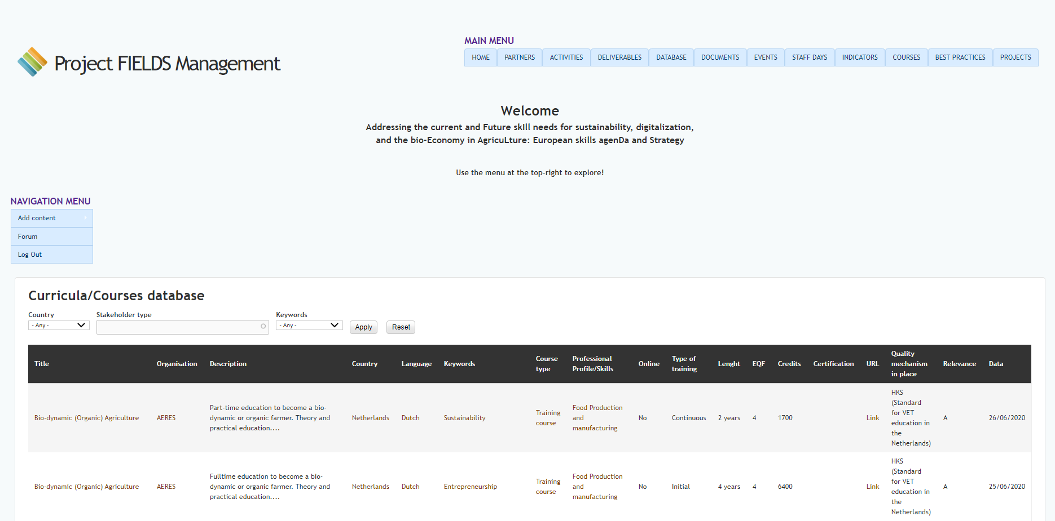

Slide 11
Policy and Advocacy
Due to the expertise of EU platforms involved in FIELDS, as agreed during February 2020 partners’ meeting in Turin (Italy), another specific database including policy-makers, decision-makers and other relevant stakeholders for advocacy has been set.
The Policy and Advocacy database includes people, not institutions, concretely policy-makers and decision-makers at different level (from local to European/international). The search can be done per “topic”, “country” or key words.

Slide 12
For each record the following information is provided:
Name and surname
Country (for European level policy and decision-makers “EU” category is applied)
Stakeholder type (same categories as “1. Organisations/stakeholders”)
EU level (representation level, such as DGs, MEPs, Permanent Representations at EU; for category reasons, also MPs, Ministry, Regional governments and others are included)
Political group (where to indicate eventually the political party of the stakeholder contact person, if relevant, e.g. for MP and MEP)
Geographical relevance of the stakeholder (local/regional/national/international/EU)
Topics (Bio-economy, Business as usual, Digitalisation, Entrepreneurship, Soft skills, Sustainability)
Email
Function (e.g. Director, Head of Unit, Policy Officer, Speaker, Spoken-person, Rapporteur, etc.)
Participation in initiatives (where to indicate if the stakeholder has been already involved in any initiative run by partner organisations, e.g., a MEP involved in a previous LLLP activity)
Intergroups or Committees (Some MPs and MEPs are involved in intergroups/committees (“Commission parlementaire” in French), where indicate if the stakeholder contact person is involved in one or more of them)
Any other further comment
GDPR box

Slide 13
Stakeholders/Target groups classification
FIELDS project identifies several target groups, classifying them according to the level of benefit:
VET providers, Trainers, Higher Education Institutes, Policy makers, Regulatory bodies and Ministries will be directly reached and will get benefit through sectoral skill strategy use.
Farmers, Farmer advisors, Foresters, Farmers and advisors representatives, Students, Students societies, Industries and Industry representatives will be reached indirectly at large scale through the implementation of the strategy, and directly reached through training at project scale (in pilot countries).
Other relevant stakeholders identified and classified as relevant target groups, mainly for dissemination activities and in other tasks where stakeholders engagement might be relevant, are: retailers; wholesalers; HORECA; technologists; bio-economists; inputs suppliers; advisors; renewable energies; logistics and specialised media.

Slide 14
The strategy to reach target groups has been and will be improved along the different phases of the project.
The creation of the database for Policy and Advocacy can be seen as tool to better address policy and decision-makers according to their level and field of influence: the classification from local to EU level, the more technical or political influence, as well as previous contacts of partner organisations with stakeholders/target groups, further facilitates the accessibility for each partner organisations to specific target groups.
The curricula/courses database allows to further classify education providers identified as target groups, being them VET or HEI: the six main topics identified (Bio-economy, Business as usual, Digitalisation, Entrepreneurship, Soft skills, Sustainability), and the kind of course provided (workshop; training course; master’s degree; high educational school; PhD; secondary school; summer school; seminar; bachelor) ensure a more targeted approach to stakeholders, as well as, as mentioned before, a support to the planned tasks and activities included in WP2 Priorities and strategy design and WP3 New tools and training design.

Slide 15
Some features
More than 120 organisations registered
More than 80 Curricula/Courses analysed
18 policy and decision-makers identified

Slide 16
Thank you!

