Slide 1

Task 3.1: Methodology definition – 30/09/2020
Enabling new pedagogical models
DISAFA, University of Turin

Slide 2
Online Learning: The evidence
National Center for Academic Transformation, USA
156 courses
195 institutions
250,000 Students
Learning outcomes were improved in 72% of the courses
  (ability to apply the material, retaining time, critical thinking…)
Cost of instruction was reduced on average 34%
Cost reduction for students as well…

Slide 3

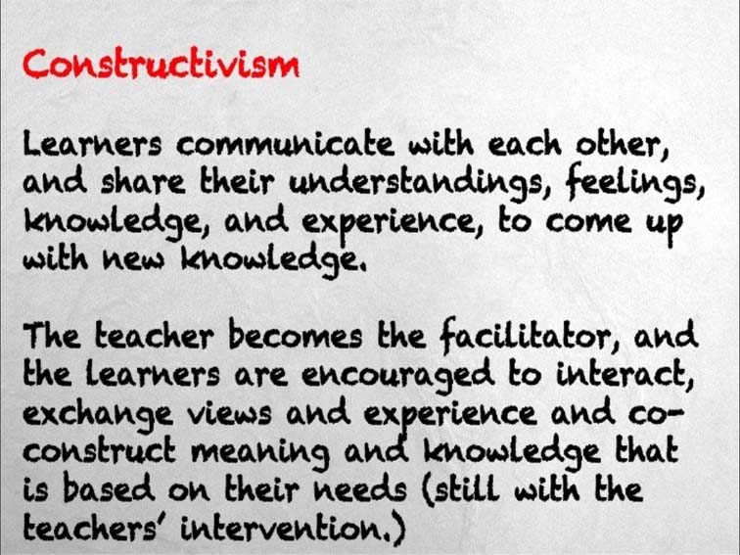
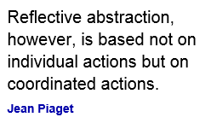

Learning Theory
Teachers must learn how to teach… they need only to be taught more effective ways of teaching
B.F. Skinner
Flipped Classroom
Behaviorism
Constructivism
1937
2000

Slide 4
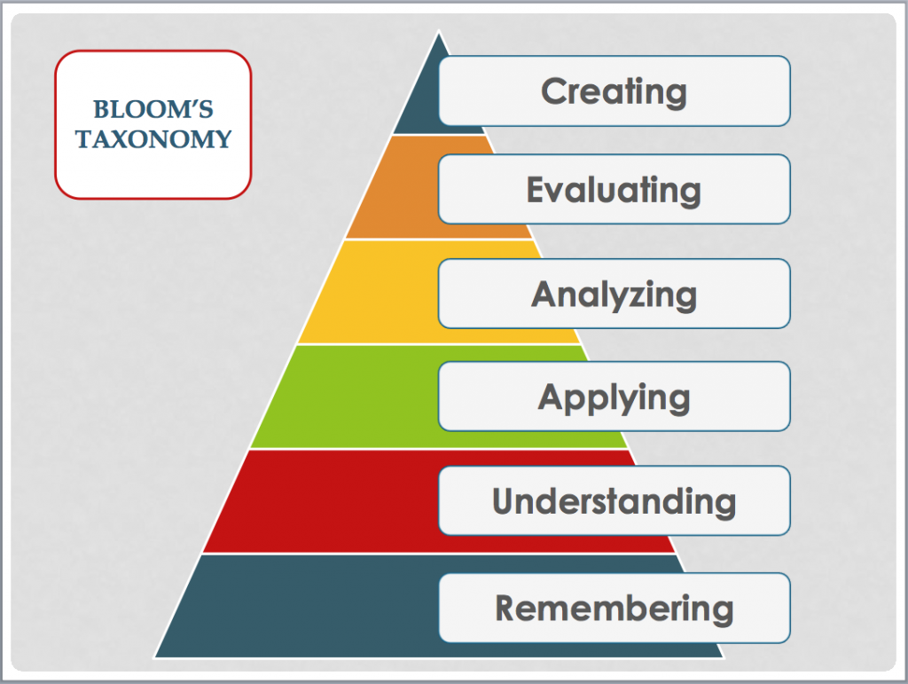

Slide 5


Traditional vs.Flipped Classroom
Traditional Classroom
Lecture is delivered by the instructor
Homework is assigned to reinforce understanding
Students watch lectures Online
Classroom time devoted to higher order thinking tasks
Flipped Classroom
Any TIME, Any WHERE, Any DEVICE

Slide 6
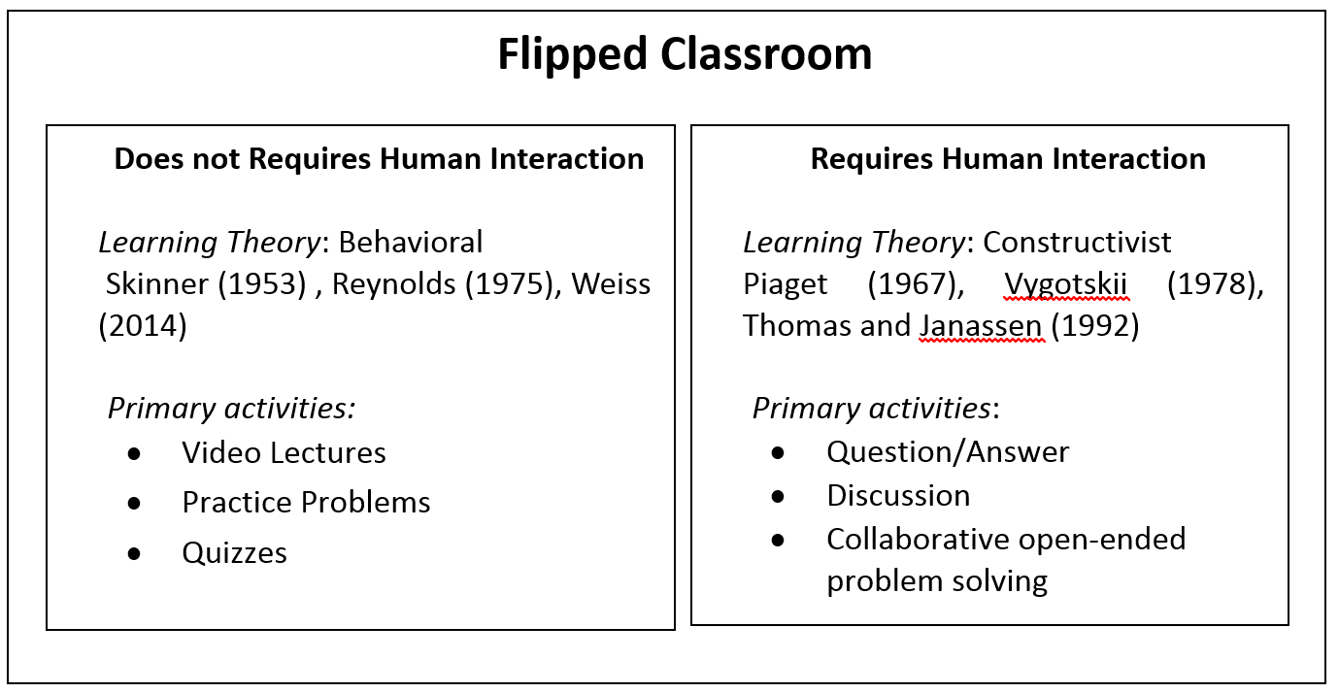

Slide 7
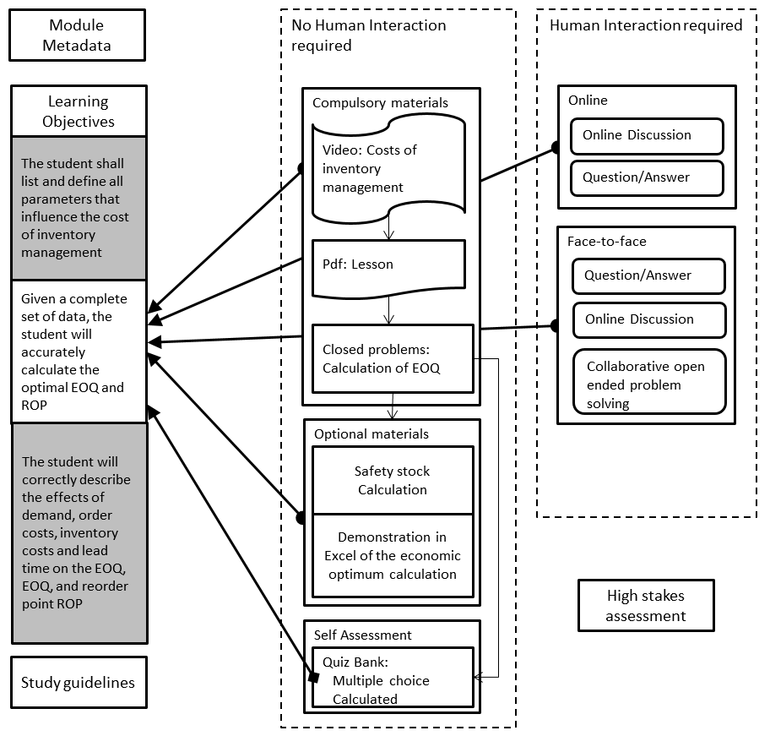
Learning object ontology

Slide 8
Face to Face in the flipped classroom
Problems selected
  Open ended problem
  Closely aligned with the learning objective
  Engaging
Students
  Students worked in teams to devise a solution or design
  Instructor provided structure and general guidance

Slide 9
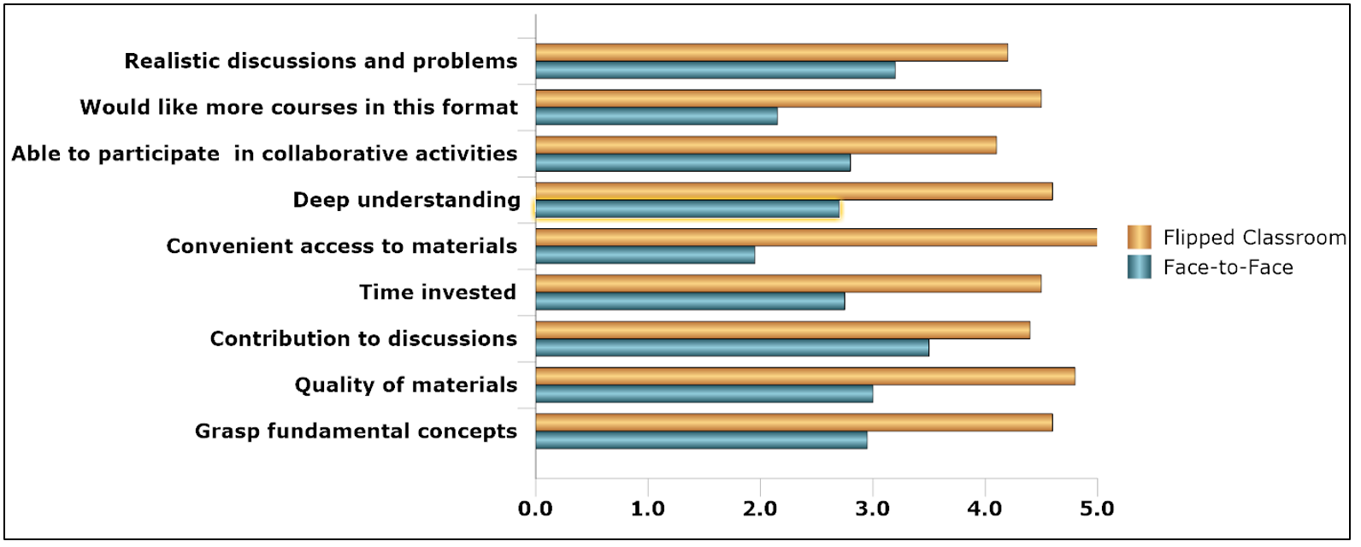
Student Preference Means
Preference for Flipped Classroom
Deeper understanding and less time invested
Convenience
Would like more

Slide 10
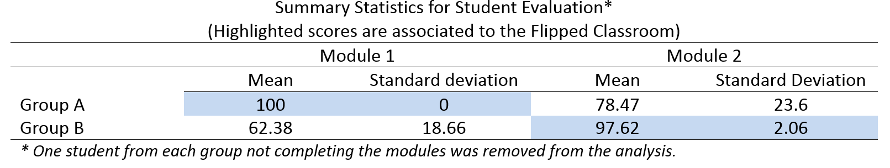
Student Performance
Flipped classroom scores significantly higher
Flipped classroom dispersion of scores lower

Slide 11
Required instructor competency
Skills to develop online materials
  Instructional design logistics
  Learning objectives
  Assessment items
  Learning assets
Skills to develop and conduct collaborative learning
  Selection of material (design problem, use case, policy, etc.)
  Group management strategies (facilitate face to face and online activities)
Technical Skills
  Course management system
  Collaboration tools
  Technical tools used by the students (simulation, GIS, web pages, etc.)

Slide 12
Benefits
Student convenience
Higher levels of achievement
Availability of learning materials anytime, anywhere, on any device
High levels of student-student and student-instructor interaction
Create a skilled workforce
Reduce costs (e.g. Travel expenses)
High ROI
Better use of classroom space
Flexibility for instructors

Slide 13
Methodology in FIELDS
With the pandemic we learn we have to teach mostly online – better to prepare material keeping in mind this shift
The design methodology will be provided with workshops to all of you
EQF level? (4-5?)
Coherent with ESCO where possible
Eventual contact with ESCO to provide new classifications
Modular (daily modules)

Slide 14
Thank you!

