Slide 1
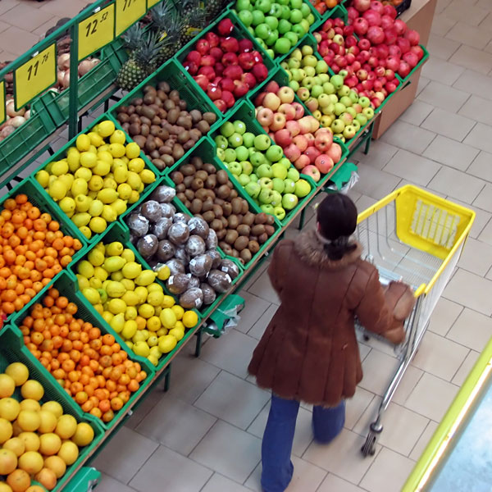
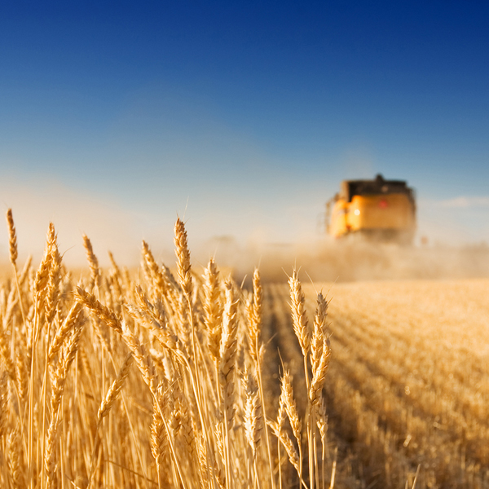
FIELDS Project Meeting 29 June 2020
Jacques Trienekens -WUR

Slide 2
WP1 Skills needs identification
WP1 Tasks
T1.1 - State of the art training and education and skill needs (per country) (M1-M6)
T1.2 – VET list and classification (per country) (M1-M6)
T1.3 – Skill needs identification through focus groups (M2-M9)
T1.4 – Web-based questionnaire design (M9-M12)
T1.5 – Scenarios on present and future skills (M8-M15)

Slide 3
Task 1.5 Scenario Development, WP1 inputs and deliverable
Input task T1.1/D1.1-D1.2: current trends and policies on sustainability, bio-economy and digitalisation (D1.1), past national and EU based projects, EU policy papers, reports, best practices (D1.2). (in agri-food and forestry)
Input tasks T1.3/D1.5 and T1.4/D1.7: trends/challenges agri-food and forestry
D1.8 Trends in digitalization, bioeconomics, systainability (,soft skills+entrepreneurship?) (covering the value chain)
D1.8 Scenario development (3 on EU level and 3 on country level)
Input T1.3/D1.5 and T1.4/D1.7: Skill needs and training needs
Input T1.1/D1.2, T1.3/D1.5, T1.4/D1.7: State of the art of education and training methods and analysis of best practices in education and training
D1.8 Education and skills policies (harmonized over EU) for different scenarios (general, will be further worked out in WP2.3)

Slide 4
Additional inputs needed
Trends and scenarios (additional to information provided by D.1.1/D1.5/D1.7)
EU Foresight reports agri-food sector, including growth strategies related to sustainability.
EU/country reports/publications on developments in Sustainability, Digitalisation, Bio-economy, (Soft skills and entrepreneurship)
EU/country reports/publications on status and development of farm and value chain business models (e.g. family/corporate, size, organization (e.g. coops), product diversification, markets, etc.)
Skills and training needs
Reports/publications (EU and sector/region/business model specific, complementary to D1.5 and D1.7 output)

Slide 5
Next steps and challenges
Identify main drivers for scenario analysis (economic, social/cultural, political/legal, technical, environmental)
Will skill and training needs identified in tasks 1.3 and 1.4 fit with scenarios?
.....

