Slide 1
WP1 Overview
FIELDS WP1
WP Start/end date: M1-M15
Partners involved: All
Aim: Establish a general overview of the labor market in agriculture, forestry and related sectors (food industry, forest-based industry) in order to define present and future skills needs related to Sustainability, Digitalisation, Bioeconomy and Soft Skills.
The outputs of this work package will be directly used in WP2, WP3, WP4 and WP7.

Slide 2
WP1 Tasks
FIELDS WP1 - Tasks
Task 1.1: State of the Art (UNITO)
Task 1.2: Stakeholders strategic mapping and mobilisation (LLL-P and EfVET)
Task 1.3: Country and EU focus groups (ISEKI)
Task 1.4: Bottom-up surveys (ICOS)
Task 1.5: Future trends analysis (WUR)
Ongoing Tasks: 1.1, 1.2 and 1.3
Task 1.4 starts M9 (September)
Task 1.5 starts M8 (August)

Slide 3

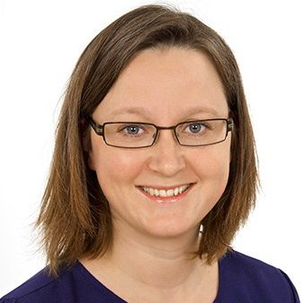
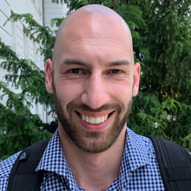
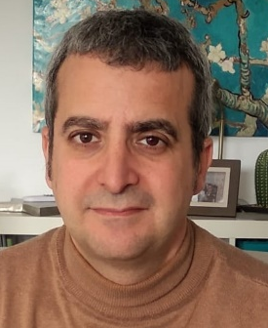
Task 1.3
Country and EU Focus Groups
luis.mayor@iseki-food.net
line@iseki-food.net
christoph@iseki-food.net
Line Friis Lindner
Christoph Knöbl
Luis Mayor
FIELDS 2nd Partnering Meeting, 29 June 2020

Slide 4
Task 1.3 Focus Groups
Aims of the FIELDS Focus Groups
Multi stakeholder approach
Education providers
Advisors
Farmers
Foresters
Agrifood companies
Forest industries
Cooperatives
Skills needs in the agriculture, forestry, food industry and related sectors
Training needs in response to identified skill needs
Best training methods

Slide 5
Task 1.3 Focus Groups
Task 1.3 activities (M2-M9)
Preparation of the Focus Group guidelines: FG conduction, FG questions, skill lists (ISEKI and all) (M2-M5)
Pilot Focus Group (Austria) and refine guidelines. (ISEKI, LVA, JF-LBT, AP) (M5)
Focus Group conduction. National and EU Focus Groups (M6)
Focus Group data processing and categorization (All) (M6-M7)
Focus group analysis (ISEKI) (M7-M8)
Focus group report (D.1.5) (ISEKI and all) (M9)
Deliverables: D1.4 Focus Group Guidelines (M6) (ready to be sent to the QC)
D1.5 Focus Group Analysis (M9)
5

Slide 6
Task 1.3 Focus Groups
Focus Group Conduction
Country | Date (2020) | Partners
Austria | 18 May | ISEKI, LVA, JF-BLT, AP
Ireland | 27 May | ICOS, PA
EU-Policy | 9 June | FDE, LLL-P, EfVET, ISEKI, Plant ETP, CEPI, COPA-COGECA
Italy | 8 June | CONFAGRI, UNITO
Germany | 10 June | UHOH
France | 15 June | ANIA, AC3A, ACTIA
Nederland | 23 June | AERES, WUR
Greece | 25 June | EFB, GAIA, SEVT, CERTH
Spain | 26 June | FIAB, UCLM, FENACORE, SCOOP, CONFAGRI-PT
Slovenia | 1 July | GZS
EU-Forestry | 2 July | CEPI
6

Slide 7
Task 1.3 Focus Groups
After the Focus Group
Reporting
Focus Group report. Please use the template provided in Focus Group Guidelines (Annex V).
This report will be included in D 1.5 “Focus Group Analysis”, as a reference of each Focus Group.
As a “thank you” note, you may send the executive summary to your participants outlining the main outcomes from your discussion.
7

Slide 8
Task 1.3 Focus Groups
After the Focus Group
Transcription
From the FG video recording.
First in local language, manually or software/web assisted. Instructions for transcribing through YouTube have been provided.
Check and edit text to ensure a good quality transcription.
Translate transcription into English. Translation functions/tools can be used (e.g. Microsoft Word or Google Translate). Check translation.
The final English transcription will be used in the data processing step.
8

Slide 9
Task 1.3 Focus Groups
After the Focus Group
Data processing
Files necessary to do the FG analysis by ISEKI. Three files:
Index file: assign codes to participants.
Skill list file: file with the skill rankings.
Data processing file. It shows processed information from the FG conduction.
Templates for these files have been provided
Austrian data processing files have been provided as reference
9

Slide 10
Task 1.3 Focus Groups
After the Focus Group
Summary
Focus Group report (Word document).
Transcription in English (Word document).
Processing files (3 Excel files): index file, skills list file, data processing file
Instructions, templates and examples have been provided by e-mail.
Please send the latest by 31st July 2020 to ISEKI-Food Association line@iseki-food.net
10

Slide 11






























Thank you for your attention!
Luis Mayor: luis.mayor@iseki-food.net
Line Friis Lindner: line@iseki-food.net
Chistoph Knöbl: christoph@iseki-food.net

