Slide 1
Presentation of database structures
Project ERASMUS+ FIELDS
Agreement 612664-EPP-1-2019-1-IT-EPPKA2-SSA-B
Curricula/courses, best practices and projects
Francesca Sanna, Project Manager
francesca.sanna@unito.it
Virtual meeting
7 May 2020

Slide 2
State of the Art (UNITO, Task 1.1 leader)
To collect the information about the state of the art, UNITO created online databases, by means of the open source platform Drupal, storing all relevant research. The database was created in the FIELDS project management platform and it will be available through the project’s public website.
It will be kept updated during the project lifetime and maintained afterwards. The databases will be further used in Task 4.3 and integrated with a geographical map as an additional layer on the website.
UNITO lead the set-up of the database, in conjunction with EfVET and LLL-P. All partners will participate and provide information related to their domain, in a form of curricula available, best practices and projects, included EU funded projects, regional pilot projects and best practices carried in the sector as well as concrete examples of policies and initiatives at the national levels.

Slide 3
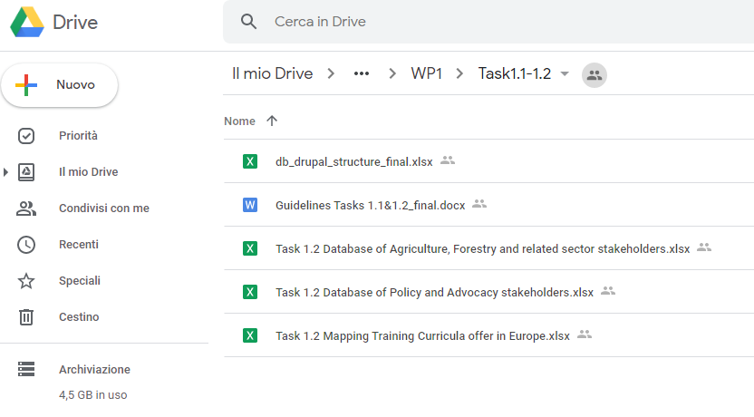
Guidelines
Data uploading and main recommendations for data collection
https://drive.google.com/open?id=12iH9Fe7mf_ZaDFEQbAiTBtMtFoSGShB9

Slide 4
Guidelines

Slide 5
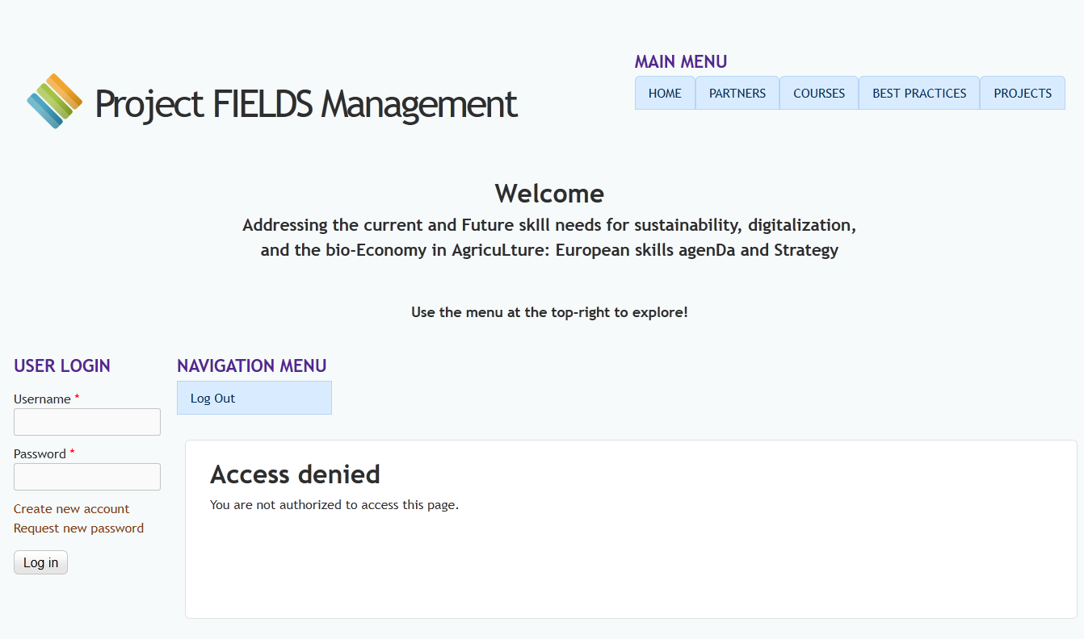
FIELDS Management portal info
http://www.erasmus-fields.eu/management/
Notes:
this link will not appear in the menu of the public page, it is only for internal use.

Slide 6
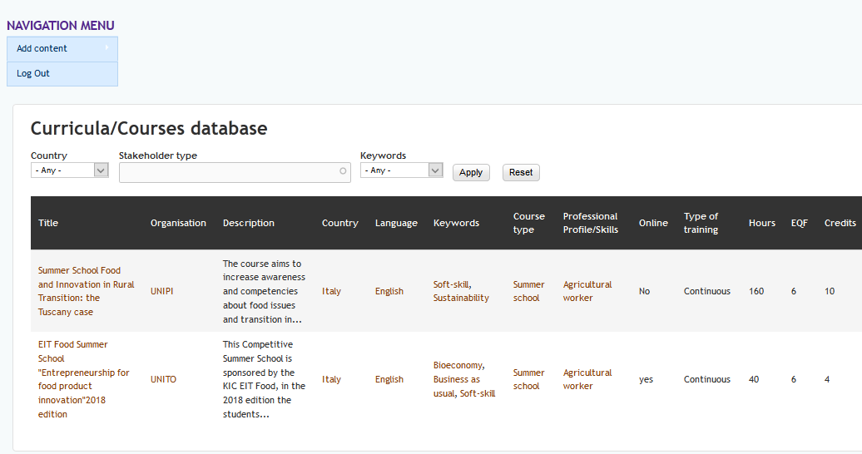
Curricula/Courses database
http://www.erasmus-fields.eu/management/?q=curricula-courses-database

Slide 7
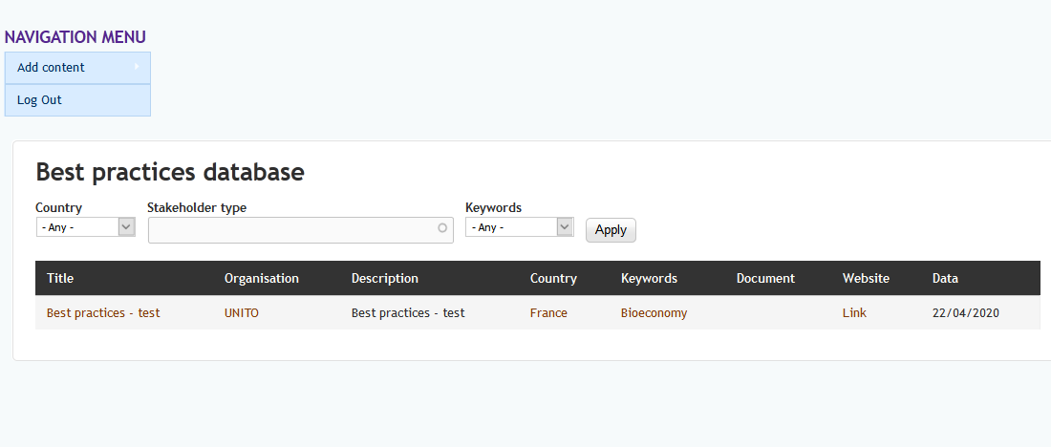
Best practices database
http://www.erasmus-fields.eu/management/?q=best-practices-database

Slide 8
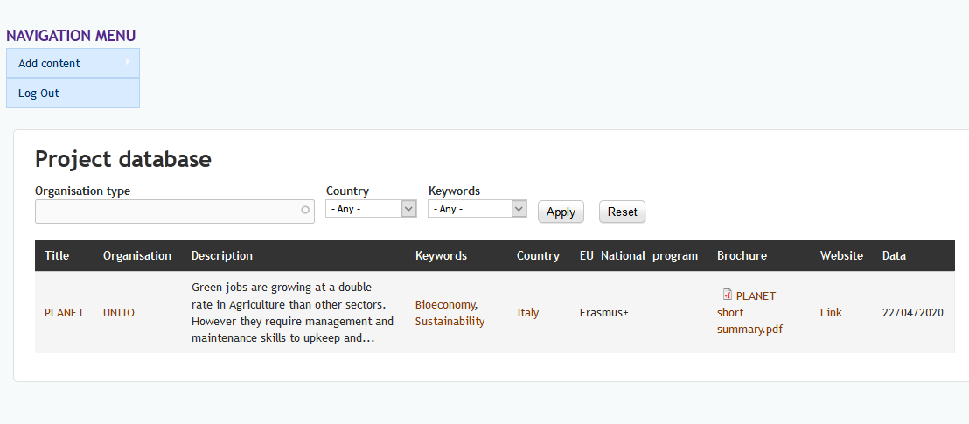
Projects database
http://www.erasmus-fields.eu/management/?q=projects-database

Slide 9
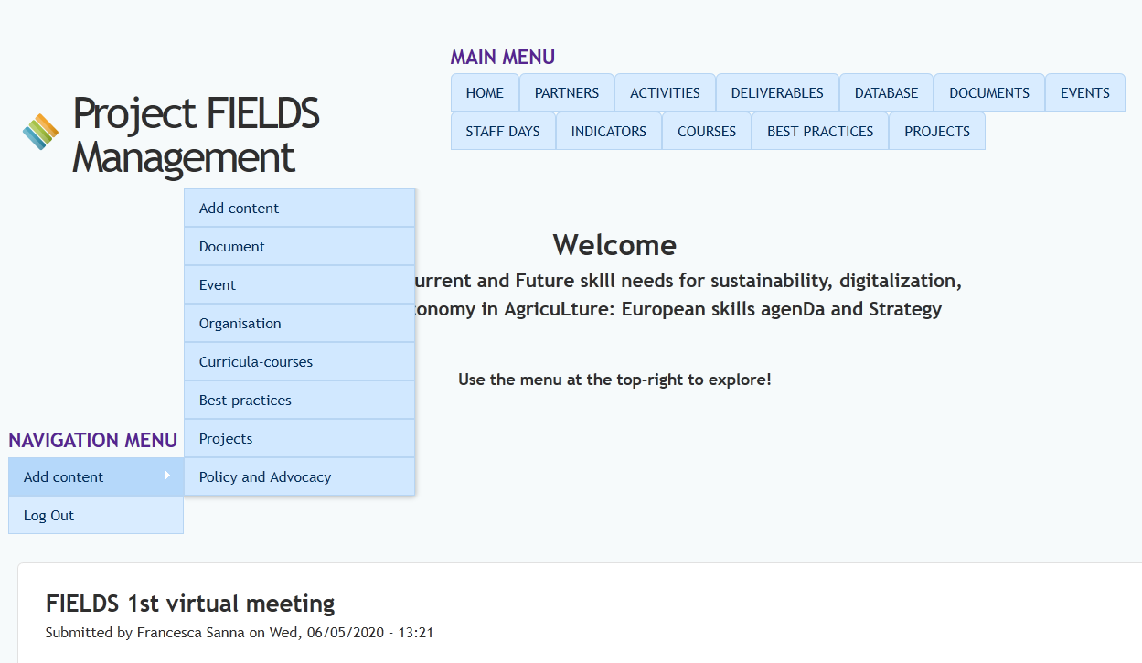
Add content

Slide 10
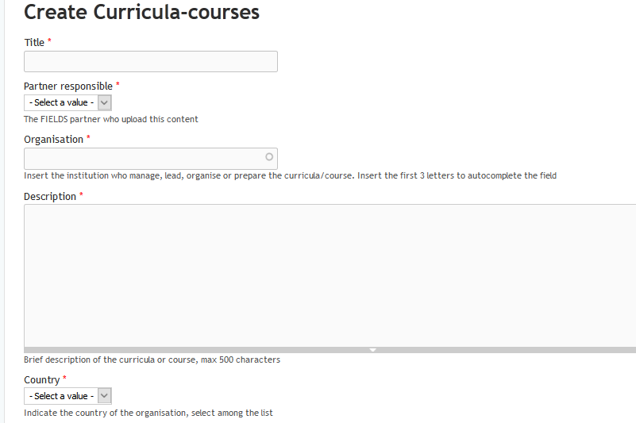
Add content to Curricula/Courses database

Slide 11
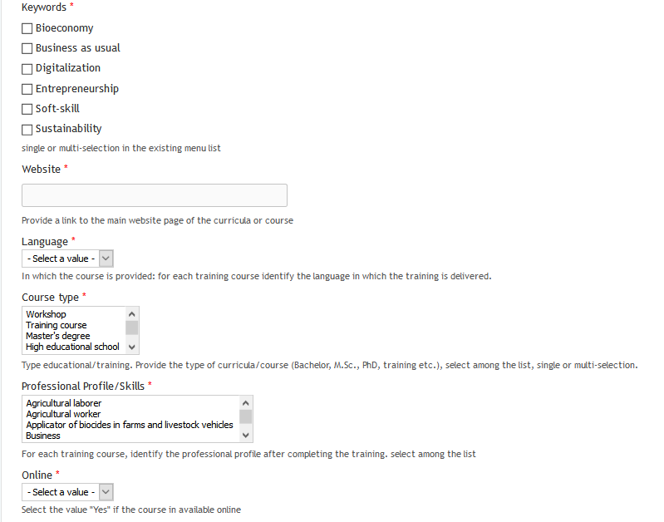

Slide 12
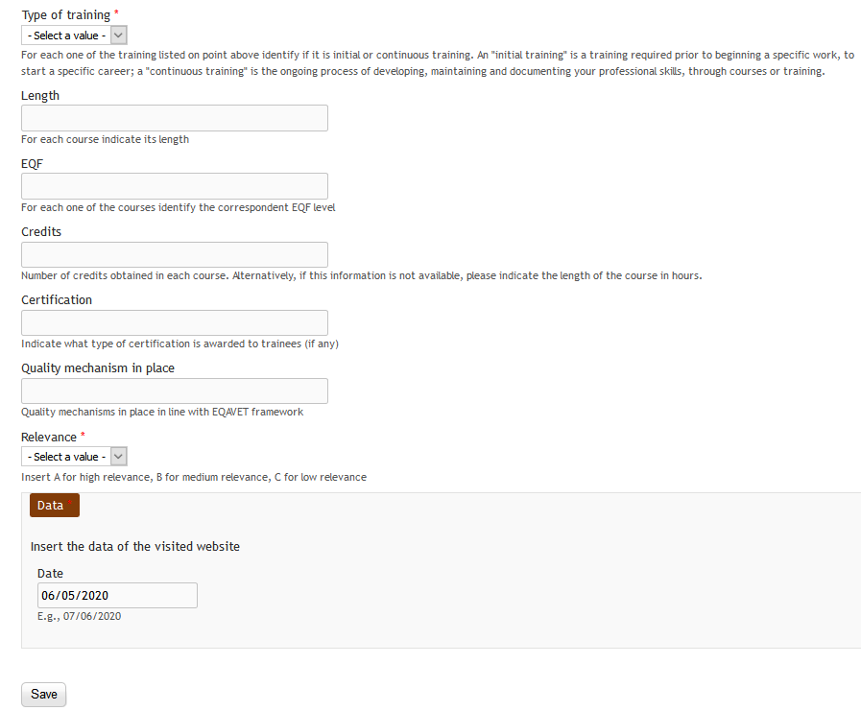

Slide 13
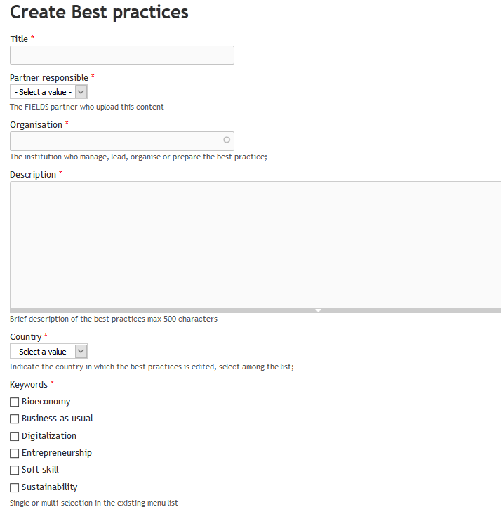
Add content to Best Practices database

Slide 14
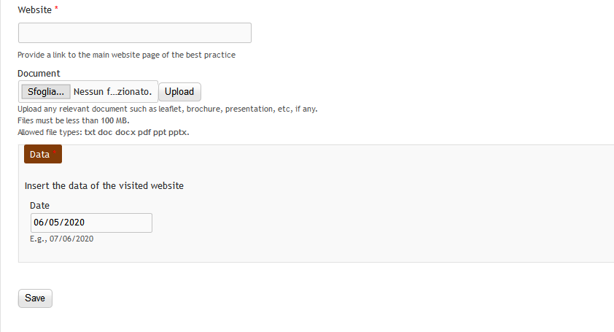
Add content to Best Practices database

Slide 15
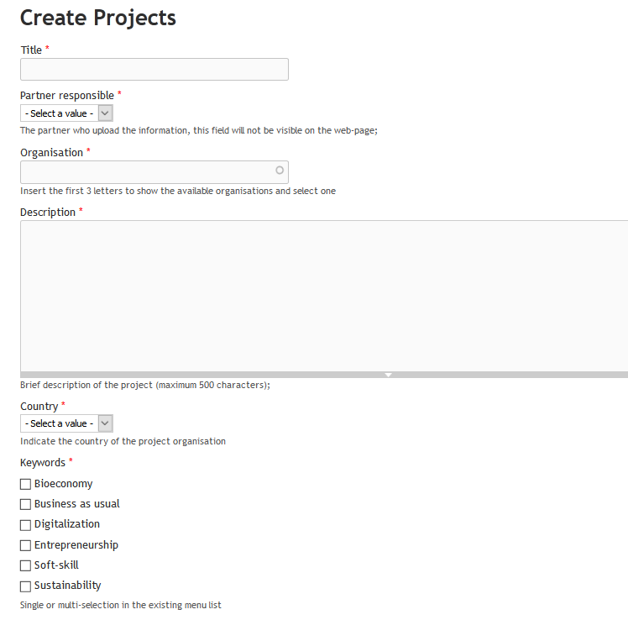
Add content to Project database

Slide 16
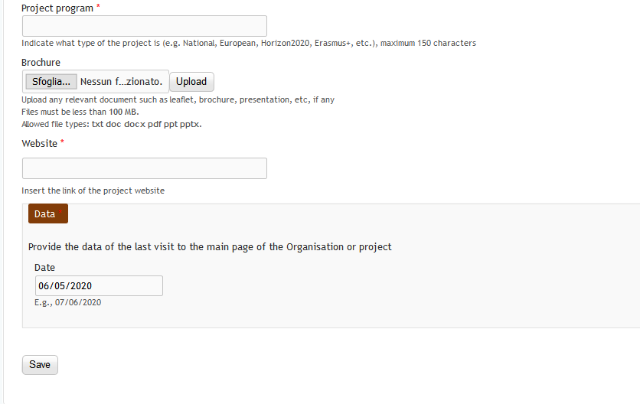
Add content to Project database

Slide 17
Any suggestions would be appreciated!
Questions/comments at the end of this event
Francesca Sanna, FIELDS project manager
francesca.sanna@unito.it

