Slide 1

FIELDS early project results
Francesca Sanna, Project Manager
francesca.sanna@unito.it
2nd Partnering meeting
29 June 2020
UNITO

Slide 2
Agenda - Project results & Future activities
 | AGENDA | Contributors
13:50 | Welcome | Remigio Berruto (UNITO)
14:00 | WP1 - Skills needs identification (ISEKI) Task 1.1: State of the Art (UNITO), M1-M6 Task 1.2: Stakeholders strategic mapping (LLL-P), M1- M6 Task 1.3: Country and EU focus groups (ISEKI), M2-M9 Task 1.4: Bottom-up surveys (ICOS), M9-M12 Task 1.5: Future trends analysis (WUR), M8-M15 | Francesca Sanna (UNITO) Riccardo Gulletta (LLL-P) Luis Mayor (ISEKI) Billy Goodburn (ICOS) Jacques Trienekens (WUR)
14:40 | WP1 – Q/A
14:50 | WP3 - New tools and training design (UNITO) Task 3.1: Methodology definition (UNITO), M4-M9 | Berruto (UNITO)
15:05 | WP3 – Q/A
15:10 | WP4 - Implementation (AERES) Task 4.3: Map creation, update and use (UNITO), M4-M48 Task 4.4: Translation (CONFAGRI), M4-M48 | Francesca Sanna (UNITO) Camilla Tomao (CONFAGRI)
15:20 | WP4 – Q/A
15:30 | Virtual Coffee break

Slide 3
Agenda - Project results & Future activities
 | AGENDA | Contributors
15:45 | WP5 - Sustainable action plan (ICOS) Task 5.1: National and EU regulatory frameworks (ConfagriPT), M7-M20 Task 5.2: Funding opportunities (LLL-P), M7-M20 | Claúdia Camacho (ConfagriPT) Riccardo Gulletta (LLL-P)
15:55 | WP5 – Q/A
16:00 | WP6 – Quality Assessment (CERTH) D6.1: Quality plan (CERTH), M1-M4 D6.2: Evaluation Grids (INFOR), M5-M6 | Aivazidou/Rodias (CERTH) Giuseppe Vanella (INFOR)
16:20 | WP6 – Q/A
16:30 | WP7 - Dissemination and communication (ACTIA) Task 7.1: Dissemination plan (LVA), M1-M9 Task 7.2: Communication and dissemination campaign (FIAB), M1-M48 | Cotillon/Cornuau (ACTIA) Drausinger/Stollewerk (LVA) Concha Avila (FIAB)
16:50 | WP7 – Q/A
17:00 | WP8 - Project Management (UNITO) Task 8.1: Decision making and internal communication, M1-M4 Task 8.2: Administrative and financial management, M1-M48 | Remigio Berruto / Francesca Sanna (UNITO)
17:20 | Future activities and next meetings
17:50 | Questions and Comments
18:00 | Conclusion and greetings

Slide 4
WP1 – Skills needs identification (ISEKI)
Task 1.1 State of the Art (UNITO), M1 – M6
To collect the information about the state of the art, UNITO created online databases storing all relevant research. The database was created in the FIELDS project management platform and it will be available through the project’s public website.
Deliverable 1.1 Stakeholders strategic plans and analysis report (UNITO), M1 – M6
The growth strategy of the sector will be summarized through the available material and directives from the EU, producers associations and industries, in a comprehensive report in M6 by UNITO, UHOH, CONFAGRI and WUR
Meeting held the 25 June to define the firsts steps on the growth strategy
of the sector
15 contribution already received from the partners

Slide 5
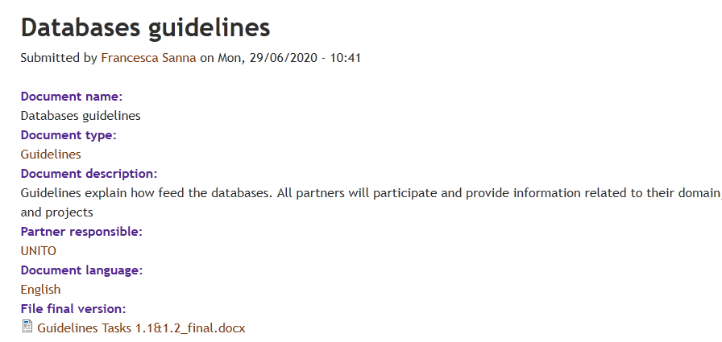
Deliverable 1.2 Repository of previous projects, results and best practices (UNITO), M1 – M6
Database feature: avoid duplication, system does not save the same records previously inserted
More info in the guidelines available in the management portal
http://www.erasmus-fields.eu/management/?q=node/1191
A target of 30 institutes to populate the platform is set for year one and a target of minimum 120 is set until the end of the project.
  Type of Deliverable: Technological/Service outputs: refer to virtual platform/services developed and provided to target beneficiaries in the context of the Fields project. It will be validated based on the document drafted to describe the features of the technological output.
D1.2 in preparation, finalizing the revised draft.

Slide 6
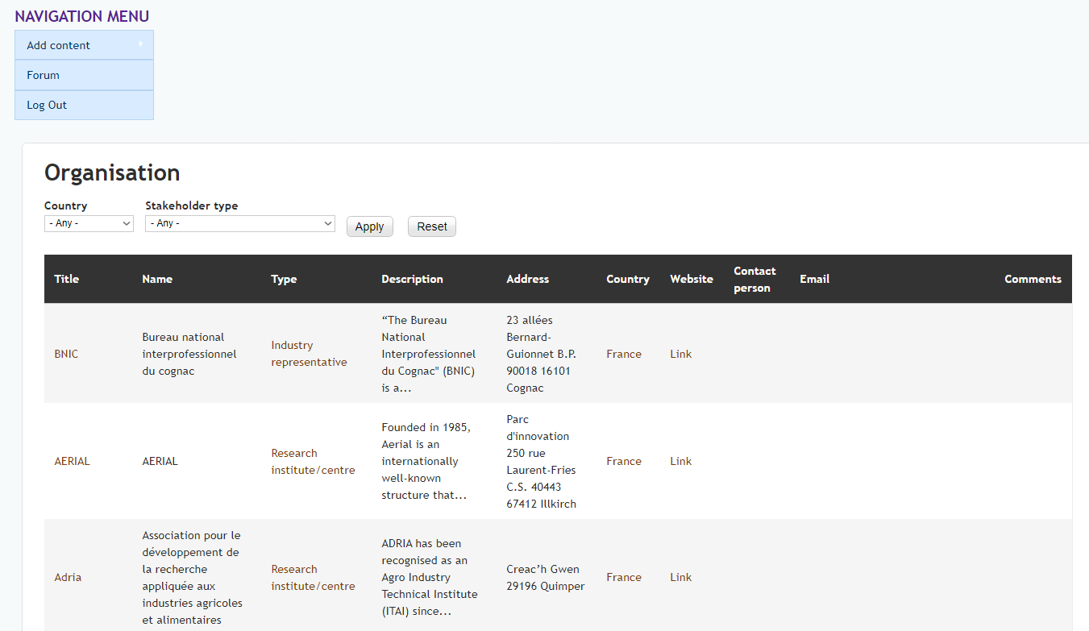

Organisations/stakeholder database
146 Organisations inserted so far!
http://www.erasmus-fields.eu/management/?q=organisation

Slide 7
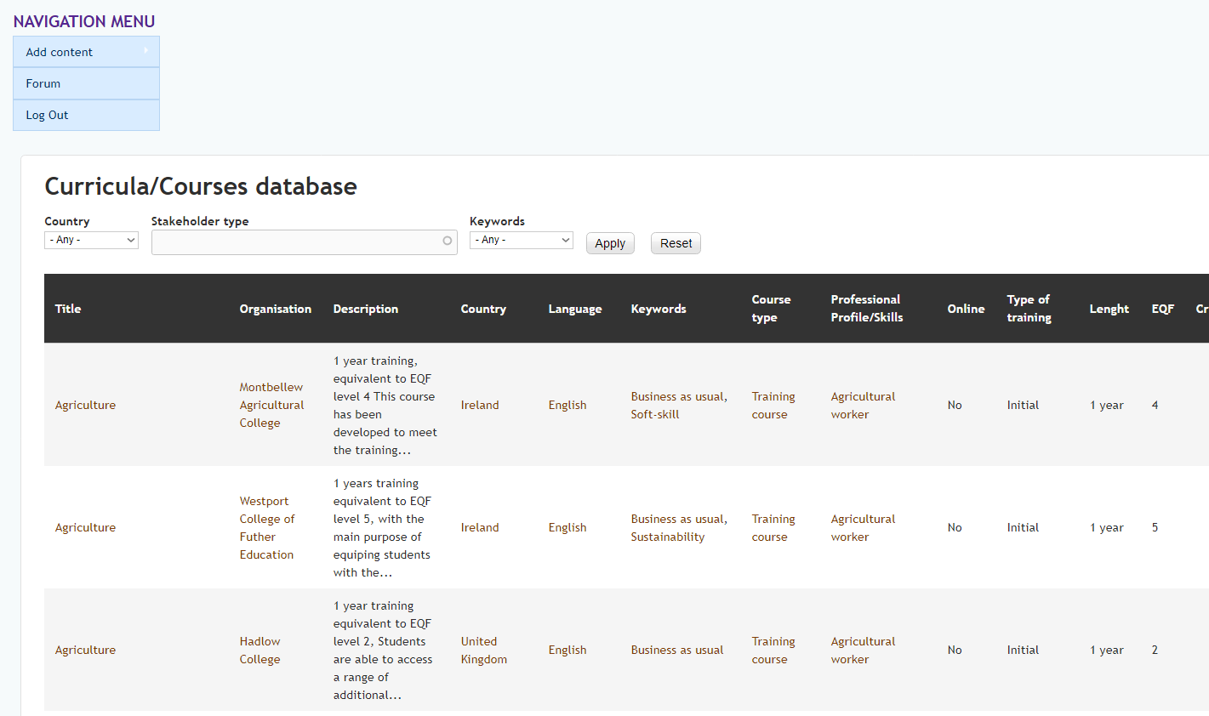
Curricula/Courses database
93 Curricula/Courses inserted so far!
21 Bio-economy; 57 Sustainability; 11 Digitalization; 15 Soft-skill;
10 Entrepreneurship; 43 Business as usual
http://www.erasmus-fields.eu/management/?q=curricula-courses-database

Slide 8
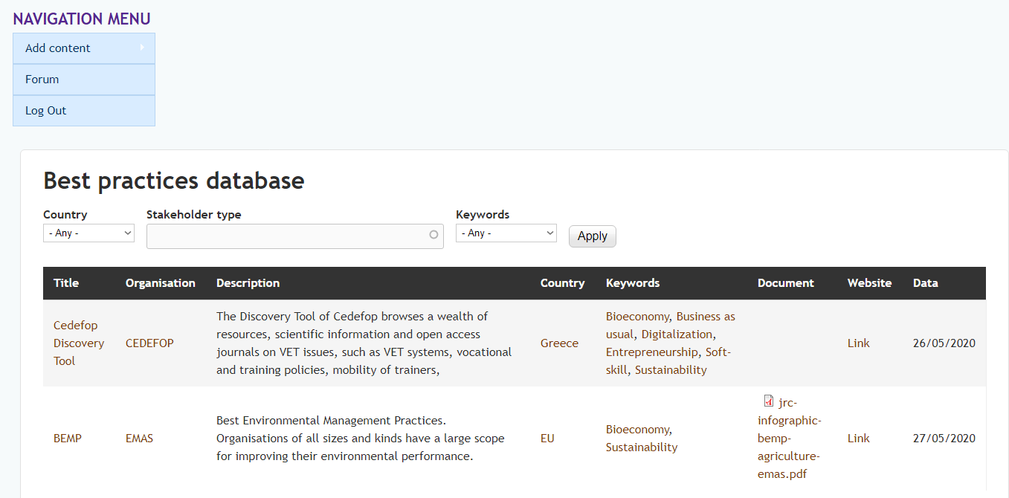
Best practices database
3 Best practices inserted so far!
http://www.erasmus-fields.eu/management/?q=best-practices-database

Slide 9
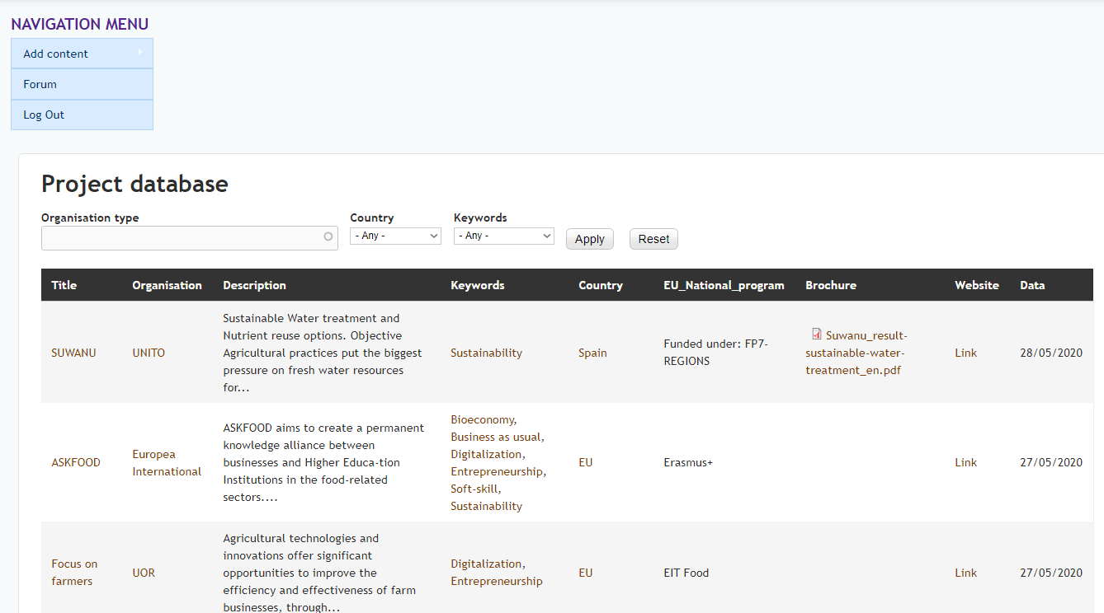
Projects database
19 Project inserted so far!
4 Bio-economy; 13 Sustainability; 7 Digitalization; 2 Soft-skill;
4 Entrepreneurship; 3 Business as usual
http://www.erasmus-fields.eu/management/?q=projects-database

Slide 10
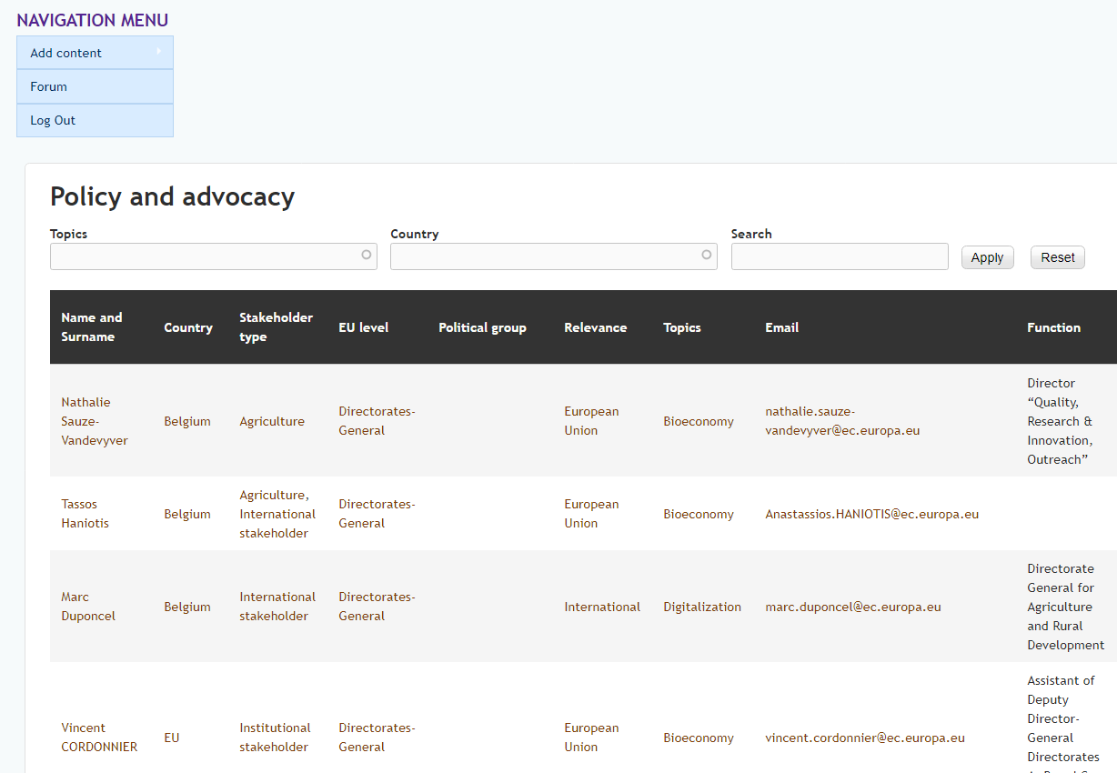
Policy and advocacy
18 Policy and advocacy inserted so far!
http://www.erasmus-fields.eu/management/?q=policy-and-advocacy

Slide 11
Questions and comments
At the end of the WP session

Slide 12
WP4 – Implementation (AERES)
Task 4.3: Map creation, update and use (UNITO), M4-M48
Francesca Sanna (UNITO)
D4.3: Online public platform and map (M12)
Task 4.4: Translation (CONFAGRI), M4-M48
Camilla Tomao (CONFAGRICOLTURA)

Slide 13
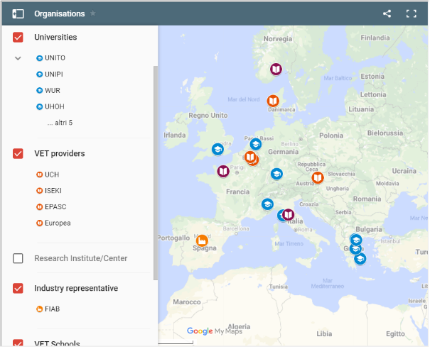
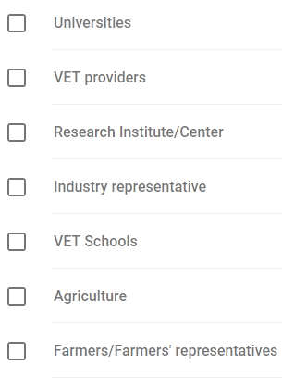
Task 4.3: Map creation, update and use
About 65 records inserted so far!
It will be kept updated during the project lifetime and maintained afterwards.
The databases will be further used in Task 4.3 and integrated with a geographical map as an additional layer on the website.

Slide 14
Task 5.2: Funding opportunities (LLL-P), M7-M24
In this task partners will study and list the funding opportunities available to support the skills strategies and the future use of FIELDS’ outputs.
Two levels will be studied (regional/national and EU levels), each partner will list the regional and national funding opportunities using the EU tender portal and the local authorities materials.
The following partners will be responsible for each country:
Austria: LVA and AP
France: ACTIA, AC3A
Germany: UHOH
Greece: GAIA, SEVT, and CERTH
Ireland: ICOS
Italy: CONFAGRI and INFOR
Netherlands: WUR and AERES
Portugal: Confagri PT
Spain: FIAB, SCOOP
Slovenia: GZS-ZKZP
All opportunities will be uploaded in the platform made in T4.3 to ensure easy monitoring and use by partners and external stakeholders.

Slide 15
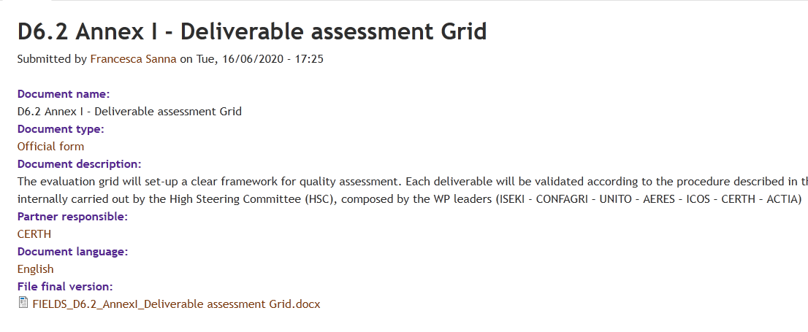
WP6 – Quality Assessment (CERTH)
Task 6.1 – Quality Plan (CERTH)
D6.1: Quality plan (CERTH), M1-M4
Aivazidou/Rodias (CERTH)
D6.2: Evaluation Grids (INFOR), M5-M6
Giuseppe Vanella (INFOR)
FOR THE HIGH STEERING COMMITTEE (HSC):
  D6.2 Annex I - Deliverable assessment Grid
  Downloadable from the management portal
http://www.erasmus-fields.eu/management/?q=node/1164

Slide 16
WP7 - Dissemination and communication (ACTIA)
Christophe Cotillon, Gemma Cornuau (ACTIA)
Task 7.1: Dissemination plan (LVA), M1-M9
Julian Drausinger, Katharina Stollewerk (LVA)
D7.1 Dissemination plan (M9)
Task 7.2: Communication and dissemination campaign (FIAB), M1-M48
Concha Avila (FIAB)
D7.2: Public Website (M3)
D7.3: Project leaflet and poster (M6)
D7.4: Report on dissemination action (M48)

Slide 17
T7.2 Communication and dissemination campaign (FIAB)
D7.2: Public Website (M3)
www.erasmus-fields.eu
Link to be added in the organisation website
First layout, also optimized for mobile phone
https://lucarivastudio.ecommerceopen.it/erasmusfields/
Feedback and comments are very welcome!
D7.3: Project leaflet and poster (M6)
Fist draft ready, prepared by an esternal desiger. It will be available in the project’s partner languages in hard copy, as well as in electronic format through the project website.

Slide 18
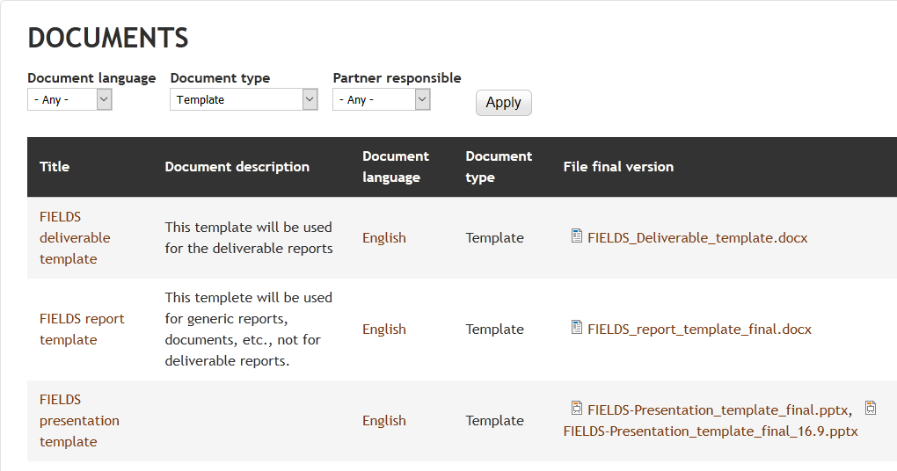
Templates

Slide 19
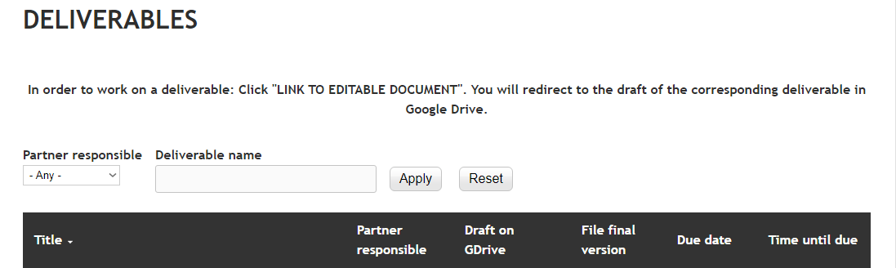
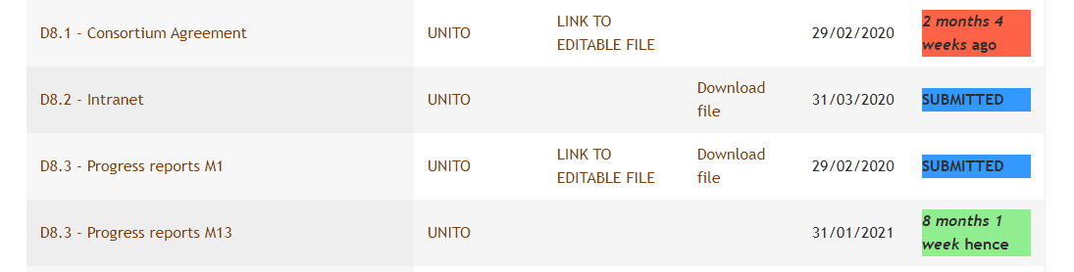
WP8 - Project Management (UNITO)

Slide 20
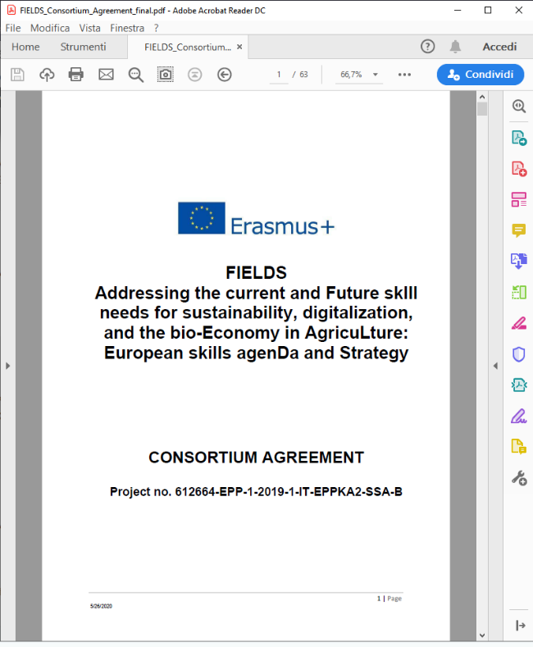
WP8 - Project Management (UNITO)
Task 8.1: Decision making and internal communication (UNITO), M1-M48
D8.1: Consortium Agreement (M1)
19 signed pages received so far

Slide 21


WP8 - Project Management (UNITO)
Task 8.2: Administrative and financial management, M1-M48
Propose: Webinar on financial issues, use of timesheet template, deadlines etc. – Q/A
Organised in October/November
(fist reporting in M13)

Slide 22
Next meetings
Meeting | Date | Place | Host
Kick-off | M1 | Turin, Italy | UNITO
Management Meeting 1 (MM1) | M13 | Vienna, Austria | ISEKI/LVA
MM2 | M25 | Paris | ANIA
MM3 | M37 | Wageningen, Netherlands | WUR
MM4 | M45 | FIAB | Spain
Final conference in Brussels | M48 | FDE | Brussels
In addition, the HSC will meet also on M6, M18, M31 and M42, with only representatives of the WP leaders. Other partners are welcome to participate.
In addition, a virtual conference call will be organised every 2 months to closely monitor the evolution of tasks and deliverables of the project
The HAB with representatives of COPA COGECA will participate to meetings in M13 and M45 upon invitation
Face-to-face meeting in Ljubljana in September/October?

Slide 23





























Thank you for your attention!
Francesca Sanna, FIELDS project manager
francesca.sanna@unito.it

