Slide 1
Deliverable 6.1 – Quality Plan
FIELDS – Blueprint 612664 – 1/1/20-31/12/23
Center for Research and Technology – Hellas (CERTH)
Efthymios Rodias, e.rodias@certh.gr
2nd FIELDS Virtual Meeting
28 May 2020

Slide 2
Contents
Purpose
Audience
Document Standards
Deliverables’ / Indicators’ / Dissemination Events’ Assessment
Management Tool
Consortium Meetings
Management Structure
Risk Assessment Plan

Slide 3
Purpose
D6.1 aims to ensure the quality of the project outputs and check the compliance with the defined objectives.
Within D6.1, a risk assessment plan is elaborated to be followed during the project.
The major objective of D6.1 is to monitor the project implementation and to set tangible performance measures.
Its overall content shall be compliant with the:
  Allocated resources;
  Outputs set in the project description;
  Expected results indicators;
  Impact indicators.

Slide 4
Audience
D6.1 will be used by:
The FIELDS Project Management team;
The Steering Committee (SC) and the High Steering Committee (HSC), both responsible for meeting the project objectives and ensuring the quality of the project output;
The Quality Committee, responsible for reviewing internally the project outputs according to the Quality Plan;
All Consortium Partners (WP and task leaders), responsible for preparing the project deliverables;
The High Advisory Board (HAB), responsible for monitoring the project, correcting and improving the outcomes, and nominating an external advisor.

Slide 5
Document Standards
All deliverables should meet the following standards:
All draft deliverables are written in English. The learning material (D3.2: Curricula) will be translated into the local language of the seven implementation countries.
Template of projects file contains:
  Names and logos of all partners
  EU logo Erasmus+
  FIELDS logo and project description
  The Agreement contract number
  Standardized chapter sequence
  Publication date
  Status: D, Draft; FD, Final Draft, A: Approved
  Author(s) name(s) and partner
Each deliverable will contain task description and summary.
The deliverable will be handed in before the deadline.

Slide 6
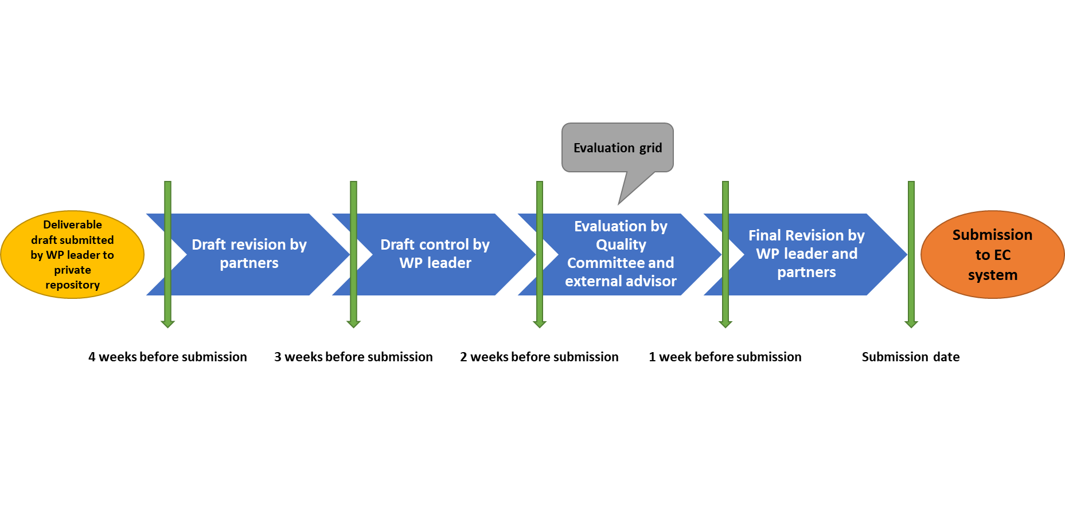
Deliverables’ Assessment

Slide 7
Indicators’ Assessment
A list of indicators will be assessed during the project implementation.
Qualitative indicators to monitor the achievement of project activities will assess the quality of the work done through the developed deliverable drafts. Each of those will receive a mark from 1 “poor” to 5 “excellent”.
For each quantifiable indicator, a numerical target will be officially to be set in the Management Meeting 1 in Vienna (M15). At the end of each related task, the target for each indicator should have been reached.

Slide 8
Dissemination Events’ Assessment
After an internal or external event, participants should deliver a report (in English) with the following information:
Title of the event
Date and location
Organiser
URL of the event
Short summary of the activity
  Objectives and Agenda
  Target audience
  Outcomes and Results
  Number of people reached
To be attached (in all internal workshops and, if relevant/possible, also in external events):
  Programme
  List of participants (e-mail and/or phone number, job title, representing organization, country of residence)
  Presentations
  Photographs and/or videos
  Other relevant documents and/or information.

Slide 9
Management Tool
Two online platforms used during the project for different purposes: 1) the Content Management System (CMS) and 2) the Learning Management System (LMS).
The CMS will contain the updated partners’ contact list, a shared repository (private for the partners) of tasks, activities, and deliverables with their status and assignment to each partner, an active calendar view, and the option to download templates, guides, dissemination tools, etc.
The LMS will be used to host the training material in all seven languages (English, Finnish, French, German, Italian, Dutch, Spanish) of the training courses. This platform will also contain the toolkit for monitoring and assessing the learners’ participation, performance, and satisfaction.

Slide 10
Consortium Meetings
Under the auspices of UNITO, biannual project meetings and online meetings (every two months) will be organised among the partners. The FIELDS consortium will also meet once a year.
The detailed agenda of the project meetings shall be distributed at least 10 days prior to each biannual meeting and 3 days before each online meeting.
Every partner responsible of a task or deliverable, is encouraged to prepare a short presentation to exhibit the state of work and arrange the discussion amongst participants.
The minutes of transnational and virtual meetings will be prepared by the Coordinator or the WP leader organizing the meeting and shared among participants by 2 weeks after the event.

Slide 11
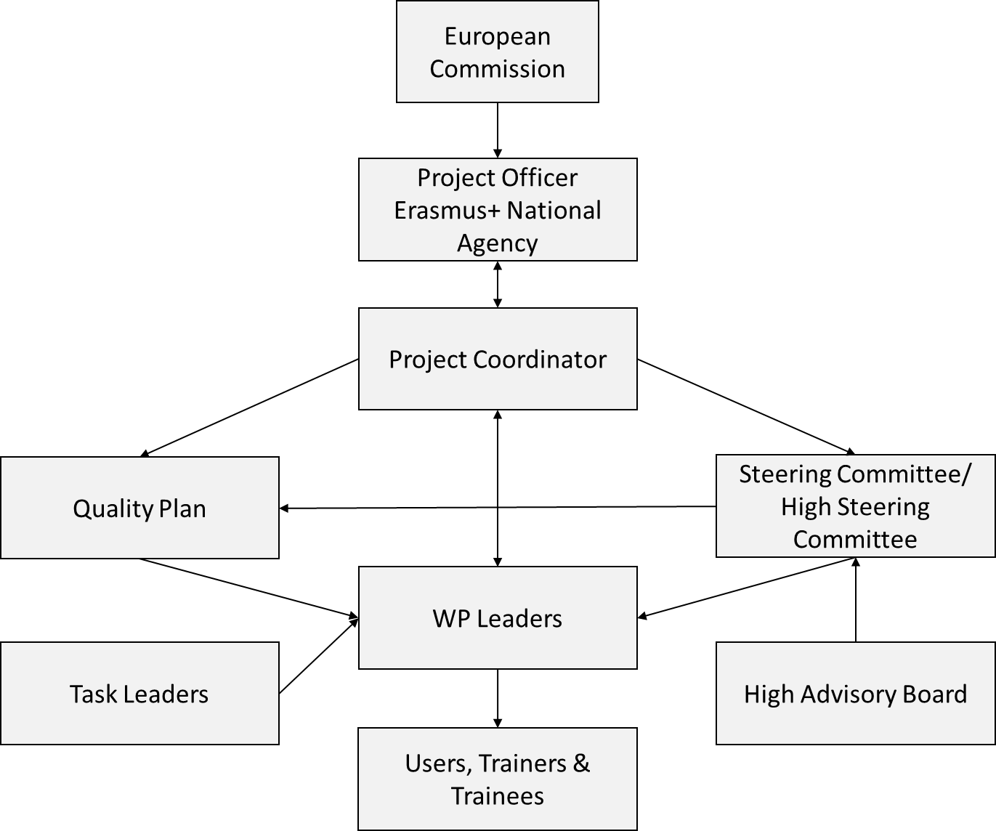
Management Structure

Slide 12
Risk Assessment Plan
Index | Level | Probability
1 | Very small | Theoretical chance. There is a next phase in the project which will eliminate or reduce the risk to an acceptable level.
2 | Small | The probability that the risk will occur is very limited. Existence of well-established control measures.
3 | Real | Failing or lacking the specific control measure does not result in the systematic presence of the risk, however the risk can be present.
4 | High | Failure or absence of the specific control measure will result in a systematic error, there is a high probability that the risk is present.
Index | Level | Effect
1 | Limited | Insignificant delays on implementation schedule. Insignificant problems on implementation costs.
2 | Moderate | Delays on implementation schedule (up to 3 months on tasks, deliverables and work packages). Increase of implementation costs up to 10%.
3 | Serious | Delays on implementation schedule (up to 6 months on tasks, deliverables and work packages). Increase of implementation costs up to 15%
4 | Very Serious | The risk has a long-term effect on the project and its results. Delays on implementation schedule (more than 6 months on tasks, deliverables and work packages). Increase of implementation costs more than 15%

Slide 13
Q&A

